Slide 1
K-5 Teacher Leader Breakout Session April 24, 2014
linda.holbrook@education.ky.gov
mary.mccloud@hazard.kyschools.us
www.kvecsstln.weebly.com

Slide 2
Pillars again
Pillars of Network Meetings…Network Foundations
Professional Learning
Highly Effective Teaching and learning
Kentucky’s Core Academic Standards
Assessment Literacy
Leadership
TPGES--Teacher Professional Growth and Effectiveness System
Notes:
Grade Level Teams

Slide 3
C3 and Literacy Standards: Working Together to Create Meaning
See C3 Page 21
Instructional Examples
Key Verbs/Nouns
Notes:
Emphasize the value in the conversation with others about standards – their intent, nuances of language, progressions, what they look like during instruction and assessment.
Suggestions
Place CHARTS from March activity on wall
Distribute HANDOUT with the chart information included to participants

Slide 4
How do we teach our students to become independent thinkers?
In order to help student become independent learners, teachers must understand how to explicitly teach students to independently use strategies and strategy tools to help them build skills that will empower them to think about their own learning. (Metacognition)
Notes:
Comprehension Handout
Strategies
Activities
Discuss

Slide 5
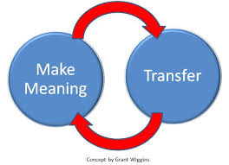
REVISIT
Collaborate with table partners to come to a shared agreement about each element of the triangle.
Create a chart of your findings. (Be sure to include the Standard # and Names on Your Chart)
Review your chart. Do you have everything required? (USE A DIFFERENT COLORED MARKER TO MAKE ANY ADDITIONS!)
Instructional Examples Goal:
What do the Social Studies Literacy Standards “look like” in my classroom?
How will I teach the literacy standard?
http://grantwiggins.wordpress.com/2012/01/11/transfer-as-the-point-of-education/
Notes:
Notes from March Meeting:
Strategy we are using to “create meaning of the Content Literacy Standards” is based on Grant Wiggins (Understanding by Design) concept of “Make Meaning and Transfer” into your own instructional practices.
We are “modeling” an excellent strategy for you to use with your social studies students!
…since “understanding” surely implies, among other things “effective use of content.” Link to a post from Grant Wiggins that discusses “MM and Transfer” if you would like additional information.
SUGGESTED NOTES FOR APRIL:
Distribute C3/Lit Stds. Chart Results Handout.
* indicate the number of times this strategy was “tagged” as someone wanting more information about it…
Review your chart information. Do you have everything required in the instructions included on your chart?
Share instructional examples that would have “fit” that part of the triangle. Our GOAL for identifying instructional examples was to determine: What do the literacy stds. “look like” in my classroom?
Revisit Charts etc. Edit and Revise (Bring charts completed in March; Mar Results Handout created by Carole; Triangle Handout from March)
I WILL REVISE THE HANDOUT BASED ON CHART ADDITIONS AND RE-SEND TO EVERYONE!

Slide 6
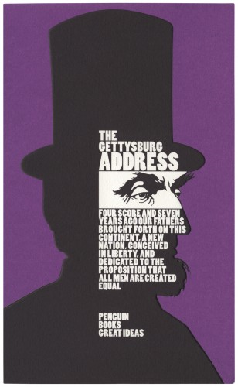
Elementary Literacy in Social Studies
INQUIRY-BASED LESSON
Notes:
Focus for this session will be Reading Standard 1 and conducting an inquiry based lesson.
We will be differentiating instruction for Primary and Intermediate levels.

Slide 7
VITAL: Reading Standard 1
5th grade: Quote accurately from a text when explaining what the text says explicitly and when drawing inferences from the text.
See C3 page 26 – feel free to annotate!
In your composition book, write one sentence that sums up the importance of the information in this section.
MIP = Most Important Point
(Comprehension Strategy –Summarization)
Analyze instruction that emphasizes the intersection between C3 and Literacy standards.
Notes:
Handout 2: Reading Standard 1 Grades K-5
Look at your grade level standards.
Progression from K-5
Skim and scan Page 26
Write the MIP in your journal
Be ready to share.

Slide 8
What other lens addresses social studies content in this lesson?
SS-05-5.2.1:
Students will identify historical documents, selected readings and speeches (e.g., Mayflower Compact, Emancipation Proclamation, Dr. Martin Luther King's speech: I Have a Dream, etc.) and explain their historical significance.
Table talk: Ideas from the Primary Classroom
See page 24 in C3 for Questioning Pathway.

Slide 9
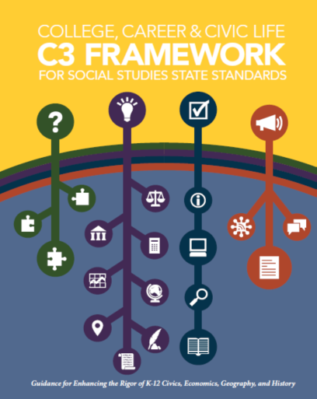
Criteria for Compelling Questions
Compelling Questions
C3 Framework: Page 23
Focus on enduring issues (field of civics) and social concerns
Deal with curiosities about how things work
Ask students to interpret and apply social studies concepts
Asks students to construct opinions in response to unresolved issues
Notes:
Go to page 23 in the C3 book
Highlight the four criteria for compelling questions.
We will be demonstrating how to conduct an inquiry based lesson using a compelling question and address these criteria.

Slide 10
Why are we reading Lincoln?
Remember: Compelling questions can grow and evolve as more information comes available.
Students build content knowledge through the discovery within their own inquiry.
Notes:
Our compelling question is “Why are we reading Lincoln?”
Give participants time to reflect on question and write on post-it note. Use Think-write-pair-share activity to share knowledge.
Instruction for next slide Handout 3. Photograph Response
We will use 2 pictures Photograph Response Intermediate and Photograph Response Elementary
Show one picture at a time use post-it note for each picture. Talk at table about observations. Count off 1-4 and do photograph response. Label picture on chart with caption from the bottom of handout.

Slide 11
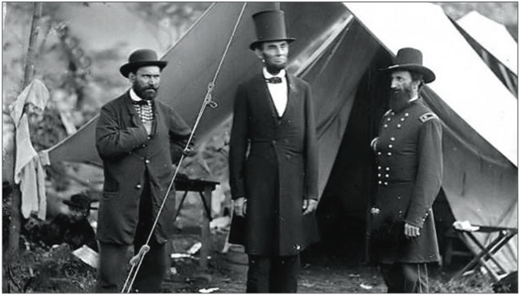
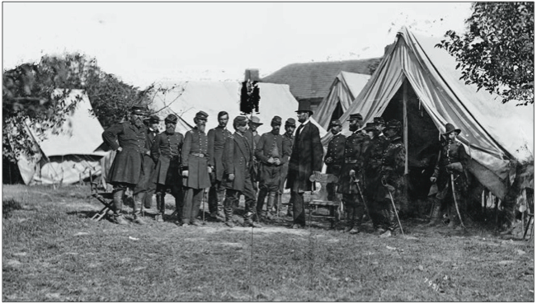
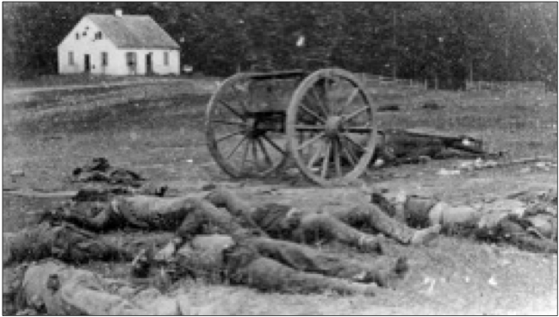
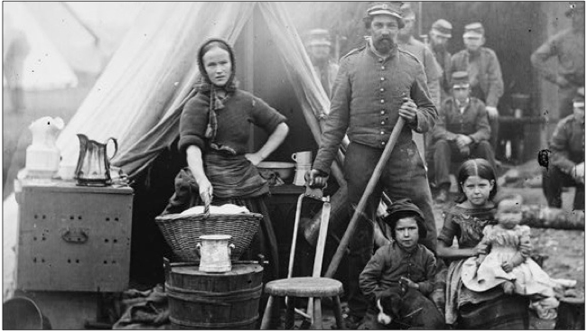
Handout #7: Photograph Response
1
2
3
4
Notes:
Use handout and make observations for each picture. (social concerns) Also write any questions you have. (generating curiosity)

Slide 12
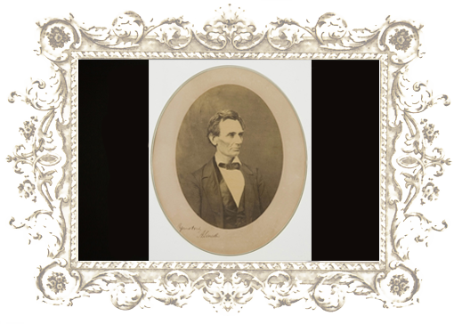
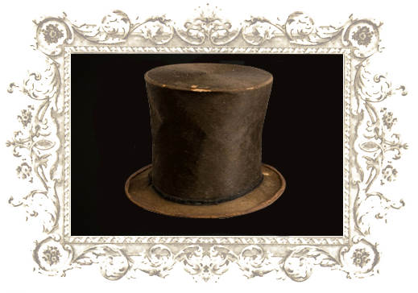
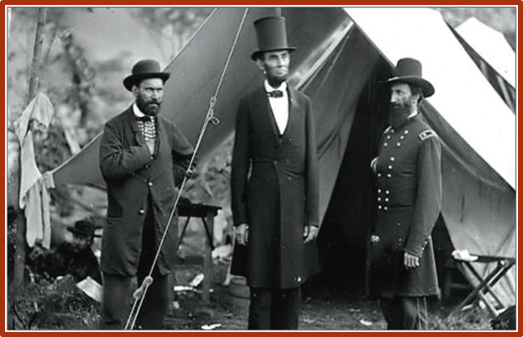
Photograph Response Elementary
1
2
3
4
Notes:
Same notes for PR Intermediate
Complete Photograph Response Handout.
Count off 1-4 address each picture. Place caption(s) under pictures posted on chart paper and discuss.

Slide 13
Use the information in the photos to aid your creation of a compelling question about Lincoln? Write the question in your journal and share. Remember our Focus RI.5.1: Quote accurately from a text when explaining what the text says explicitly and when drawing inferences from the text.
Notes:
Build background knowledge Handout Abraham Lincoln Biography.
Write a compelling question about Lincoln based on the text.
Share at table

Slide 14
Use a short passage
“Read with a pencil”
Note what’s confusing
Reread several times for multiple purposes
Provide opportunities to return to the text to extract evidence, verify key information, answer questions through what the text states and inferencing.
Creating a Close Reading
Notes:
Close reading is an intensive analysis of a text in order to come to terms with what it says, how it says it, and what it means. Close reading directs students to examine a text through a series of activities that focuses students on individual words or sentences as well as overall development of events and ideas.
Suggested process from Fisher and Frey

Slide 15
The Gettysburg Address (1863) by Abraham Lincoln
Our purpose is to gain understanding of the ideas and values in the text, among others: citizenship, democracy, sacrifice, social construct.
Notes:
We will be conducting a close read activity on The Gettysburg Address during our inquiry based lesson. “Why are we reading about Lincoln?” Remind participants that this is done in the classroom with multiple days.
Continue to build background knowledge Handout : Handout 3: The Battle of Gettysburg
(These handouts and lesson materials are found: http://www.el.standord.edu Lesson #2)
Distribute Handout of Gettysburg Address Read silently annotate text
Set the purpose
Have a TL to read “Gettysburg Address” aloud

Slide 16
The Inside Story of Lincoln’s Top Hat (Elementary)
Read silently
Annotate text
Highlight new learning
“Why are we reading Lincoln? (Compelling Question)
Notes:
Http://www.smithsonianmag.com/history/abraham-lincolns-top-hat-the-inside-story-3754960/#VVoOcjY3XH.99

Slide 17
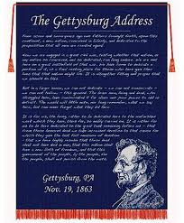
“Gettysburg Address” or "The Inside Story of Lincoln's Top Hat"
Read silently.
One person Read Orally
At your tables, read aloud in 4 Voices (see back of speech)(Gettysburg Address only)(Choral Read).
At your tables assign 1-3 and read (The Inside Story)
Text-dependent question: Of the 266 words contained in this speech, which one is most significant? Defend using quotes from the text.
In your opinion what statement was new learning for you. Defend your choice. (The Inside Story of Lincoln’s Top Hat)

Slide 18
Compelling Question
Reflect, add, modify to finalize your compelling question
Post question on chart paper
K-2
3-6
or

Slide 19
Lesson Reflection and Applications
REFLECT as TEACHER
Go back to C3 Framework: Pg. 26 in C
Reflect on the activity of close reading, citing evidence (Literacy Standard 1), and inquiry (Compelling Question).
Was the intent achieved? How?
What elements of this lesson can you use this in your classroom?
Share at tables.
Record reflections in your journal.

Slide 20
Journal Entry
What is a Social Studies concept/unit/lesson that you
will teach before the end of this
school year that is a “good fit”
for a close read?
Social Studies
Teacher Leader Network
Notes:
Handout Pearson Table of Contents from Kathy Swan’s book list for generating ideas for addressing SS in primary classroom.

