Slide 1
World Languages Global Competency
Alfonso De Torres Núñez, World Languages Consultant
Kelly Clark, lead consultant Global Competency
Jamee Barton, lead consultant Program Reviews
By PresenterMedia.com

Slide 2
ARE YOU READY?

Slide 3
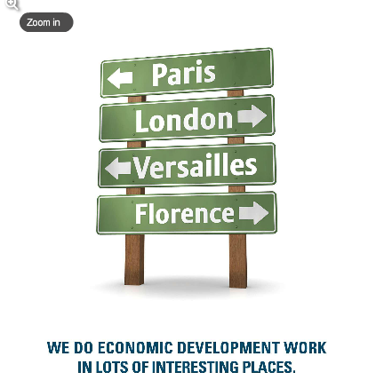
Why Kentucky?

Slide 4
Did you know…?
Based on the June 4th 2015 report of the KY Cabinet of Economic Development:
There are 439 facilities with foreign ownership
There are 86,500+ full-time jobs tied to those facilities
Three examples: There are at least 175 facilities tied to Europe, 173 to Japan and 12 to Mexico

Slide 5
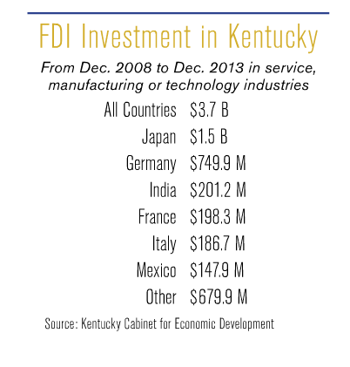

Slide 6
Did you know…?
From the US Department of Commerce, just in 2013 (awaiting for all year results from 2014):
Kentucky ranked 2nd in the nation among states for percentage export growth and 8th in the U.S. for exports on a per capita basis.
Kentucky exports totaled a record $25.285 billion in 2013.
Kentucky ranks 18th in the nation in total exports.
Kentucky’s total exports increased by 14.3% or $3.16 billion from 2012 to 2013.
Manufactured goods accounted for nearly 98.5% of all Kentucky exports in 2013.
Kentucky exported to 198 countries during 2013.
Top export industry sectors in Kentucky include: Aerospace,
motor vehicles, synthetic fibers, pharmaceuticals, and basic chemicals.
Canada, Mexico, the United Kingdom, China, Brazil, Japan, France,
and Germany are Kentucky’s top export markets.

Slide 7
Did you know…?
Examples of facilities with foreign ownership in the region that you lead:
Pike Co.: SGS Mineral Services (Switzerland)

Slide 8
QUIZ
What are the top Kentucky industries?
Please, be fair and do not google the answers
Kentucky’s Top Industries
When people think Kentucky, they don’t jump to industry or manufacturing right away. (Besides food, coal and horses)
Automotive
Biotechnology and Life Sciences
Manufacturing
Transportation and Logistics
Sports and Recreation

Slide 9
Ripped from the headlines in the last months….
Electrolux to buy GE Appliances Business for $3.3 billion deal that positions Swedish group to challenge Whirlpool as the leader in sector's U.S. Market.
Lexmark makes offer on Swedish software company.
Kentucky & China collaborate on a large-scale carbon capture project.
Lincoln MKC brings 300 new jobs to Louisville Assembly Plant.
Ford Motor Co. invests $129 million in Kentucky.
Midea Corporation plans to locate its first U.S. research and development operation in Jefferson County, Kentucky. Midea will create up to 25 new jobs and invest nearly US$2.7 million in the project.
The Japanese-owned company, Riken Elastomers Corp., is investing more than $22 million in expanding its plant and adding workers in Hopkinsville, Kentucky.

Slide 10
Mapping the Nation www. mappingthenation.net

Slide 11
BE AWARE!!! Global Competency isn’t Only about teaching world language….
LET ME ASK YOU A QUESTION…
USING THIS DATA:
Are we preparing our students for the world that they will find once they graduate?
Some of them will choose college, some others they will join the work force.
Are we providing them with the skills to function in this world?
ARE WE PREPARING THEM TO BE
GLOBALLY COMPETENT?

Slide 12
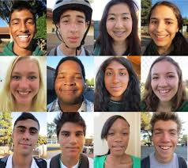
It’s about essential skills for students
Understanding.
Investigating.
Connecting.
Integrating.

Slide 13
What is Global Competency?
From a NATIONAL EDUCATION
ASSOCIATION policy brief
on the issue:
In depth knowledge and understanding of international issues
An appreciation of and ability to learn and work with people with diverse linguistic and cultural backgrounds
Proficiency in a world language
Skills to function productively in an interdependent world community

Slide 14
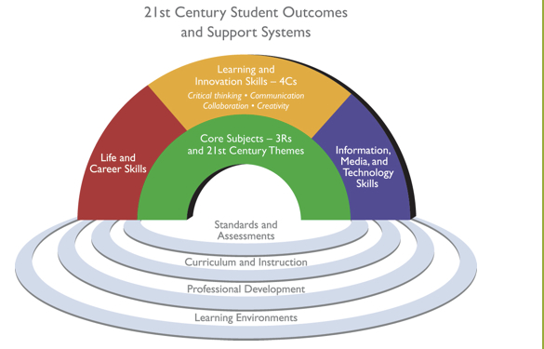
Where does it come from?
Framework for 21st century learning
Learning and Innovation Skills (4 Cs)
Critical Thinking, Communication, Collaboration and Creativity

Slide 15
Where does it come from?
Kentucky Rising
WHAT? It is a statewide strategic plan focused on a “cradle” to “career” model to improve the economy of the Commonwealth and the prosperity of citizens of the Commonwealth.
GOAL: Kentucky will have a workforce that is among the world’s most highly skilled, globally aware, and globally competent.
METHOD: KY Rising will involve key stakeholders in a working group to develop the statewide cradle to career strategic plan.
TIMELINE: Analysis by March 2015, development by August 2015.

Slide 16
Where does it come from?
Kentucky Rising
It is not a new initiative or program
It pulls together KY business and higher education partners and state stakeholders in an intentional plan to support Kentucky schools and have every student graduate college career ready.
It supports and intersects with ALL content areas, especially social studies. An emphasis on Kentucky Rising as an intentional focus aligns the rigor of KCAS, PGES, 21st Century Skills and Program Reviews while developing a skilled and highly adaptable workforce.

Slide 17
What is the Global Competence Matrix?
The Global Competence Matrix was created as part of the EdSteps project.
It was created by the Council of Chief State School Officers in partnership with the Asia Society Partnership for Global Learning.
It provides detail about the overall definition of Global Competence and how it might be demonstrated by students.
6 content-area matrices with additional information and perspectives relevant to each content area and its objectives.
Provides teachers and students with a way to look at global competence through the different content area lenses.

Slide 19
Resources for World Languages
Kentucky Department of Education www.education.ky.gov
NEW!!!
Kentucky Department of Education
World Languages webpage
http://education.ky.gov/curriculum/conpro/Worldlang/Pages/default.aspx

Slide 20
Resources for Global Competency
Kentucky Department of Education website
www.education.ky.gov
Kentucky Department of Education: Global Competency webpage
http://education.ky.gov/curriculum/conpro/glocomp/Pages/default.aspx
NEA Foundation website (former EdSteps website)
www.neafoundation.org
Council of Chief State School Officers website
www.ccsso.org
Asia Society Partnership for Global Learning
www.asiasociety.org

Slide 21
Resources for 21st Century Skills
Resources for Kentucky Rising
Partnership for 21st Century Skills website
www.p21.org
Partnership for 21st Century Skills: Content Maps
http://www.p21.org/our-work/resources/for-educators#SkillsMaps
Global Competency grade level indicators (Partnership for 21st Century Skills and VIF International)
http://learn.vifprogram.com/indicators
Kentucky Department of Education website
www.education.ky.gov
NEW!!!
Kentucky Department of Education World Languages webpage
http://education.ky.gov/curriculum/conpro/Worldlang/Pages/default.aspx

Slide 22
Let’s try it!

Slide 23
Can you make an example of activity that address this outcome?

Slide 24
Some examples…

Slide 26
Time for a Break :)

Slide 28
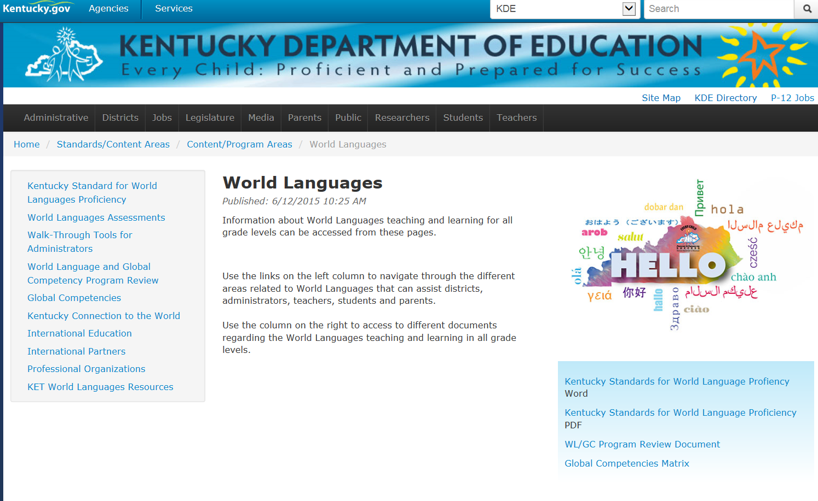
NEW!!! Kentucky Department of Education - World Languages webpage http://education.ky.gov/curriculum/conpro/Worldlang/Pages/default.aspx

Slide 29
World Languages / Global Competency Program Review

Slide 30
World Languages / Global Competency Program Review
PURPOSE?
WHO IS RESPONSIBLE?
HOW TO WORK WITH IT?
MEASURE?
IMPLEMENTATION?
NEWS

Slide 31
World Languages / Global Competency Program Review
PURPOSE?
To look at entire school programs to self-monitor your effectiveness, to see areas of both success and improvement.
To ensure equity of access for all students in the various areas beyond “The Core”
To ready students for life beyond high school (college readiness)
EX: in World languages, the PR meets expectations of college entry requirements which are based on proficiency, not two years seat time

Slide 32
World Languages / Global Competency Program Review
HOW TO?
Read the question first and note the expectations
Start from the left (No implementation - where do you find yourself?).
Read carefully the indicators and note the progression in the language set for the expectations (e.g. None → Some → Most → All)
What evidence can be triangulated?
Provide a rationale that clearly illustrates how the evidence communicates the status of the program and next steps for its improvement.

Slide 33
World Languages / Global Competency Program Review
RESPONSIBILITY?
World Languages? World Languages teachers
Global Competency? All teachers
Side by side comparison…

Slide 34
World Languages / Global Competency Program Review
World Languages 2013
World Languages / Global Competency 2014
Dem 1 Student Access: Proficient
The school provides regular opportunities for all students, including heritage speakers, to learn and develop benchmarked proficiencies in at least one world language by scheduling time for instruction, learning opportunities, and monitoring.
Dem 1 Student Access: Proficient
The school provides regular opportunities for all students, including English Language Learners (ELL), to learn and develop benchmarked proficiencies in at least one world language and provide multiple opportunities for all students to experience a range of global cultures, issues and connections (e.g., by scheduling time for instruction, providing resources and monitoring).
Dem 1 School Leadership -Proficient
Leadership selects, implements and evaluates program models designed to meet language proficiency targets and students’ individual needs and college and career readiness goals.
Dem 1 School Leadership -Proficient
School leadership fully implements policies that have been established to ensure that world language and global competency concepts are taught throughout the school and across the curriculum.

Slide 35
World Languages / Global Competency Program Review
MEASURE?
World Languages Assessments
Developing policies and procedures that incorporate WL/GC into the natural flow of school instruction, rather than an add on or after school program
Global Education Checklist by Fred Czarra
http://www.globaled.org/fianlcopy.pdf
Growth in PR characteristics

Slide 36
Implementation World Languages / Global Competency Program Review
High School → Implementation 2014-2015
At the June 4 meeting, the Kentucky Board of Education approved the following plan for the implementation of Program Reviews:
All districts’ high schools will pilot the World Language Program Review (WL PR) in 2014-15, entering information and evidence in ASSIST to set their baseline. High schools will be held accountable for the WL PR in 2015-16.

Slide 37
Implementation World Languages / Global Competency Program Review
Elementary & Middle Schools → Implementation 2015-16
Elementary and middle schools will be given the option to choose to use the current WL/GC Program Review rubric to upload evidences as a 2014-15 “informational pilot”.
They would be using that information to more fully inform program planning and improvements for 2015-16. All entered information could be maintained for the statewide pilot year (2015-16), only updating changes as new evidence is produced. Elementary and middle schools will be held accountable for their WL PRs in 2016-17.

Slide 38
Implementation World Languages / Global Competency Program Review
Elementary & Middle Schools → Implementation 2015-16
At a minimum, all elementary and middle schools in 2014-15,
under leadership of school-based decision making councils, will
answer the questions in the WL/GC Program Review
template in ASSIST but not upload evidences as baseline data.
This provides each elementary and middle school the
opportunity to become more familiar with the rubric, examine
current practices, identify needs, and create a stronger
programmatic improvement plan PRIOR to the required
statewide pilot/baseline setting year.

Slide 39
Implementation World Languages / Global Competency Program Review
Elementary & Middle Schools → Implementation 2015-16
These schools also will answer two questions around what
resources (time, training, human, fiscal) are necessary to
implement the program review in 2015-16. This will be key
information that the KDE uses in planning supports for the
successful implementation of this program review.
Done!

Slide 40
World Languages / Global Competency Program Review
NEWS
We are revising, refining the language of the WL/GC PR based on the feedback received from the field.
There will be another round of Learn and Launch grants to increase the number of schools that are part of the Kentucky Global Schools Network– RFA’s will go out by August
There will be three more Global Symposiums in the coming months- dates to be announced.
WL/GC PR will not be audited for 15-16.
On 15-16, 24 total schools will be audited on other areas.

Slide 41
It is not about getting kids comfortable with where they are, but where they are going to be in 20-30-40 years
World class education
Experiences in collaboration
Knowledge of other cultures, diversity of thought
World focus rather than a local focus
Knowledge of interconnected world economies and markets
Ability to be competitive world-wide
Knowledge that career and jobs may exist across town or across oceans

Slide 42
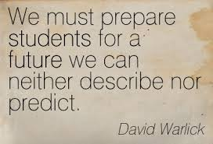

Slide 43
World Languages / Global Competency
Alfonso De Torres Núñez, World Languages Consultant
Alfonso.detorresnunez@education.ky.gov
Kelly Clark, lead consultant Global Competency
Kelly.clark@education.ky.gov
Jamee Barton, lead consultant Program Reviews
Jamee.Barton@education.ky.gov

