Slide 1
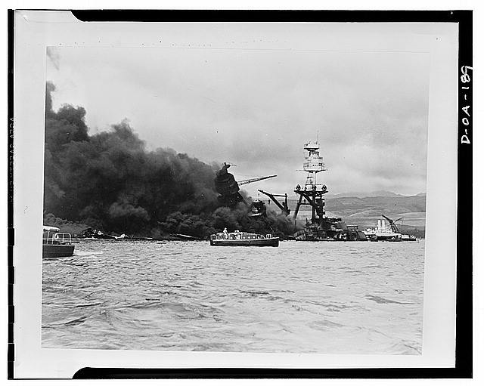
Remembering Pearl Harbor
(Franklin D. Roosevelt Library, NLR-PHOCO-A-8150(29))

Slide 3
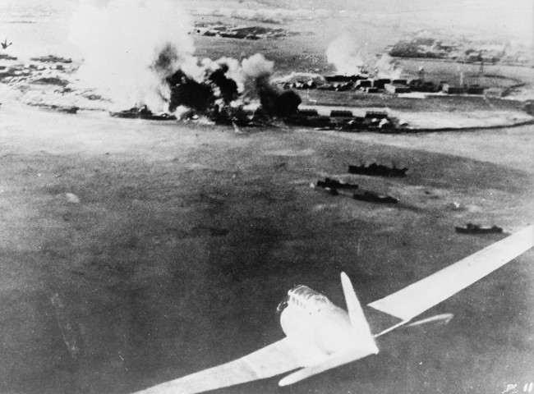

Slide 4
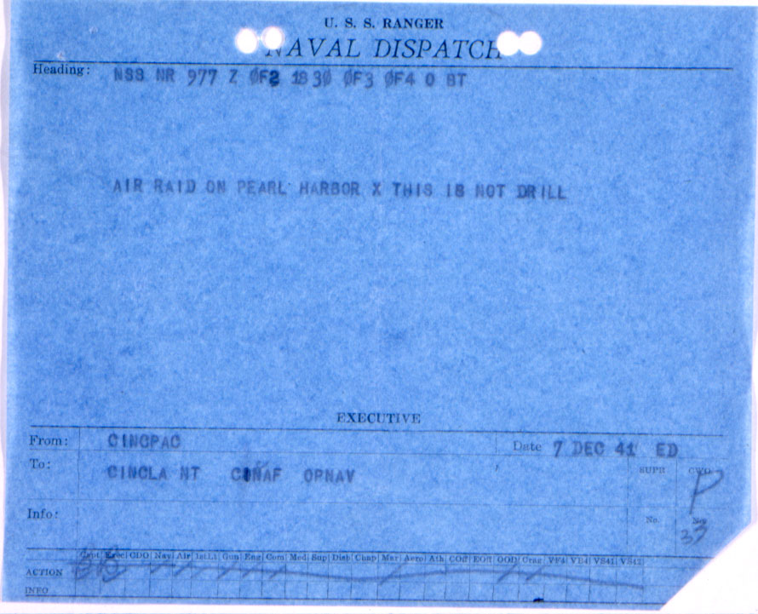

Slide 6
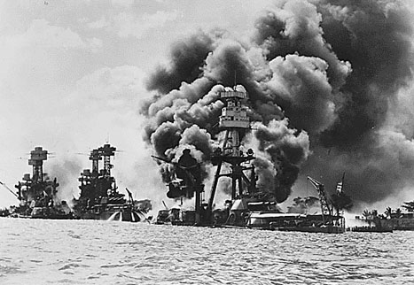

Slide 7
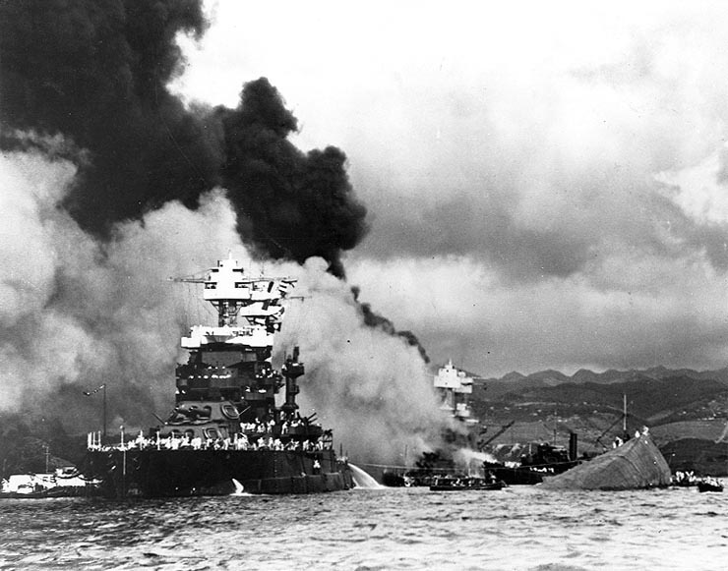

Slide 9
