Slide 1


Social Studies
Teacher Leadership Network
May 15, 2015
www.kvecsstln.weebly.com
Notes:
9:00 Jennifer C.
WELCOME
Sit in District Teams

Slide 2


Facilitators
Jennifer Fraker, KDE Social Studies Academic Program Consultant
Jamee Barton, KDE Academic Program Consultant
Carole Mullins, KVEC Literacy Instructional Specialist
Jennifer Carroll, KVEC Principal and Teacher Leadership
Mary McCloud, KVEC Elem. Social Studies Facilitator
Guest Presenter:
Alfonso De Torres Nunez, KDE World Language Consultant
Notes:
Jennifer - Introductions

Slide 3
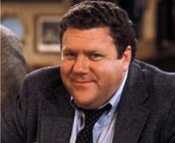
Social Studies Leadership Network NORMS
Be an ambassador of “lifelong learning.”
Show your enthusiasm for the work, support the learning of
others, be willing to take risks, participate fully.
Come to meetings prepared.
Be on time, any preparations/ readings completed, with
necessary materials.
Be focused during meetings. Stick to network goals/ targets, use technology to enhance work at hand, limit sidebar conversations.
Work collaboratively. All members’ contributions are valued and honored, seek first to understand, then be understood

Slide 4

Targets
Understanding the Social Studies C3 Inquiry Practices
Identifying the Differences Between Compelling and Support Questions
Identifying a Strategy that Encourages the Power and Intent for Social Studies Curriculum Development:
“Considerations for Curriculum Development” (CCD)
Recognizing Important Components of the World Languages Program and the Alignment to Social Studies
Recognize how the Digital Learning Resource Library, ICURIO, provides access to Social Studies resources that address 21st Century Learning Skills.
Notes:
Jennifer
Tracking Your Day Handout

Slide 5
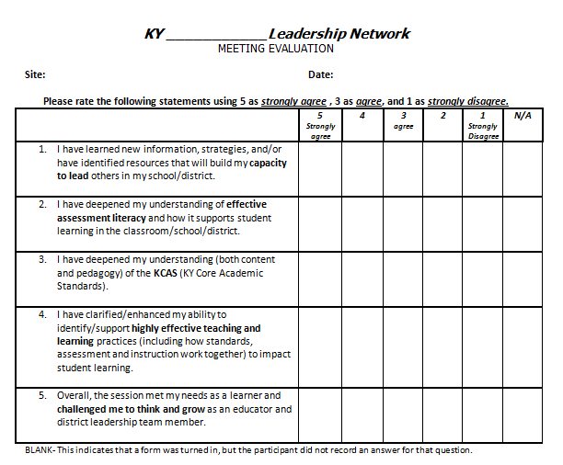
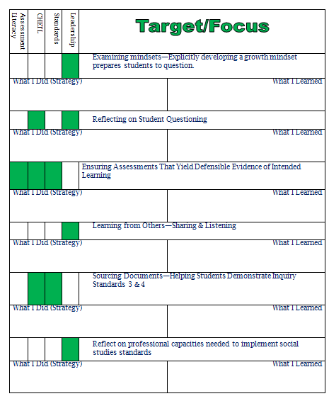
Tracking Your Day
Notes:
Jennifer
Have participants complete this section of evaluation:
“What support have you provided to schools, teachers, and/or students as a result of the knowledge/skills gained at the last meeting?”

Slide 6


Kentucky’s Core Academic
Standards
Characteristics of Highly
Effective Teaching and
Learning/KY Framework for
Teaching
Assessment Literacy
Leadership

Slide 7


Questions about Questions

Slide 8
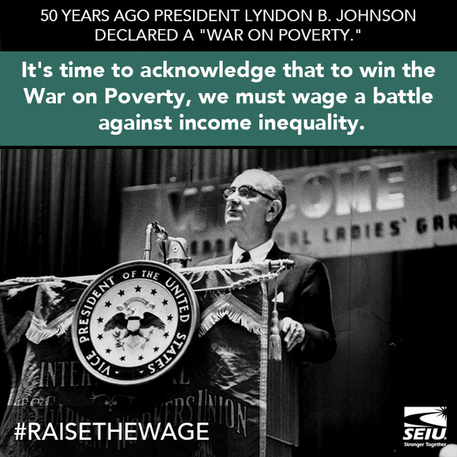
http://archive.org/details/ACoplandAppalachianSpring
Notes:
http://archive.org/details/ACoplandAppalachianSpring

Slide 9
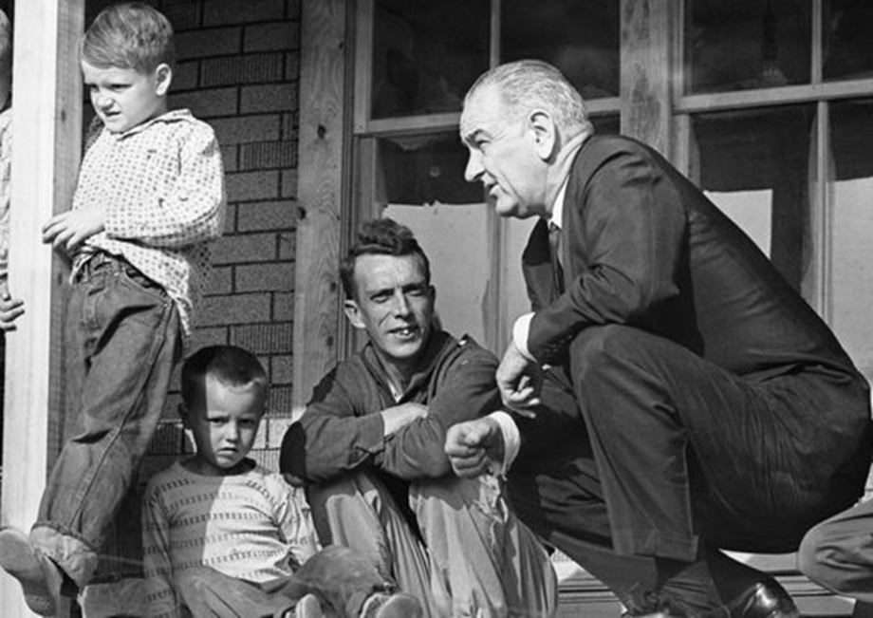

Slide 10
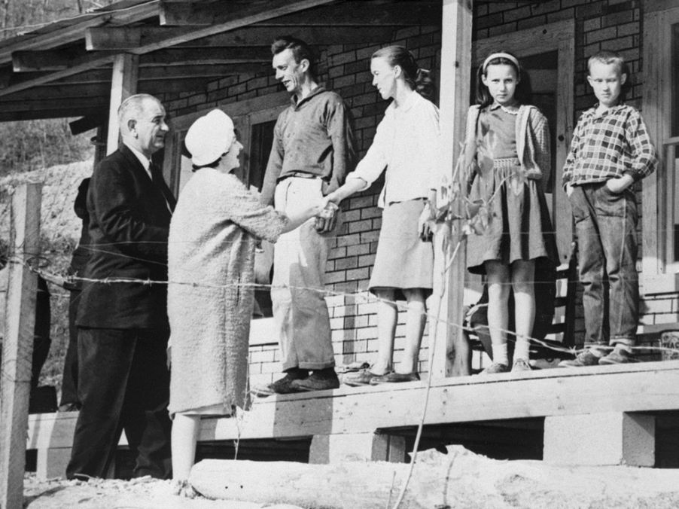

Slide 11
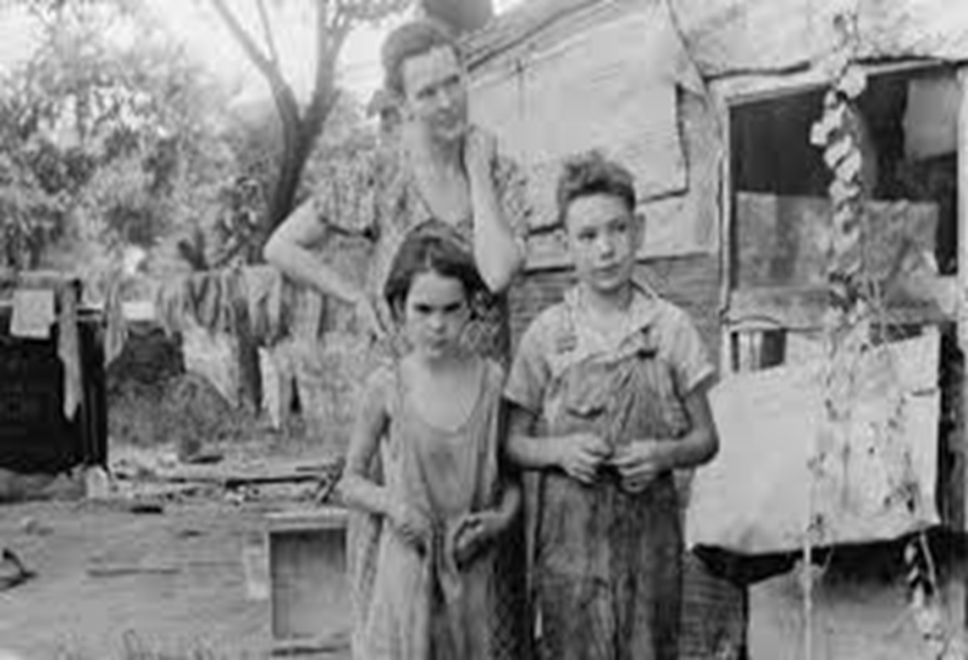

Slide 12
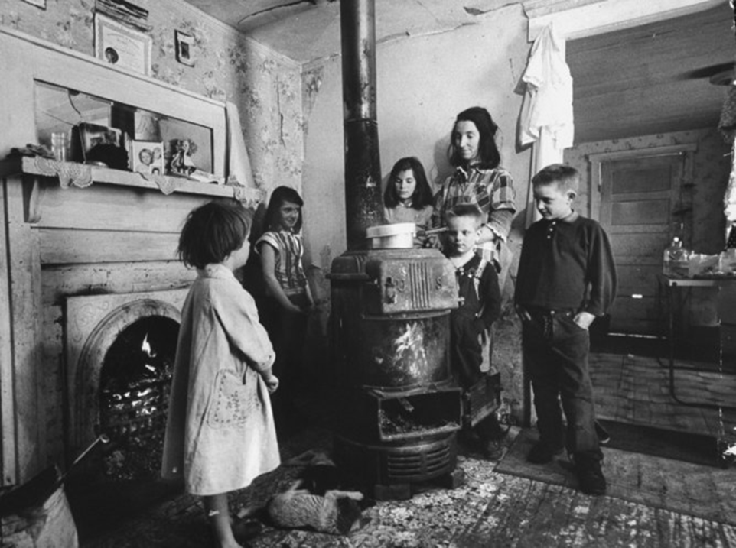

Slide 13
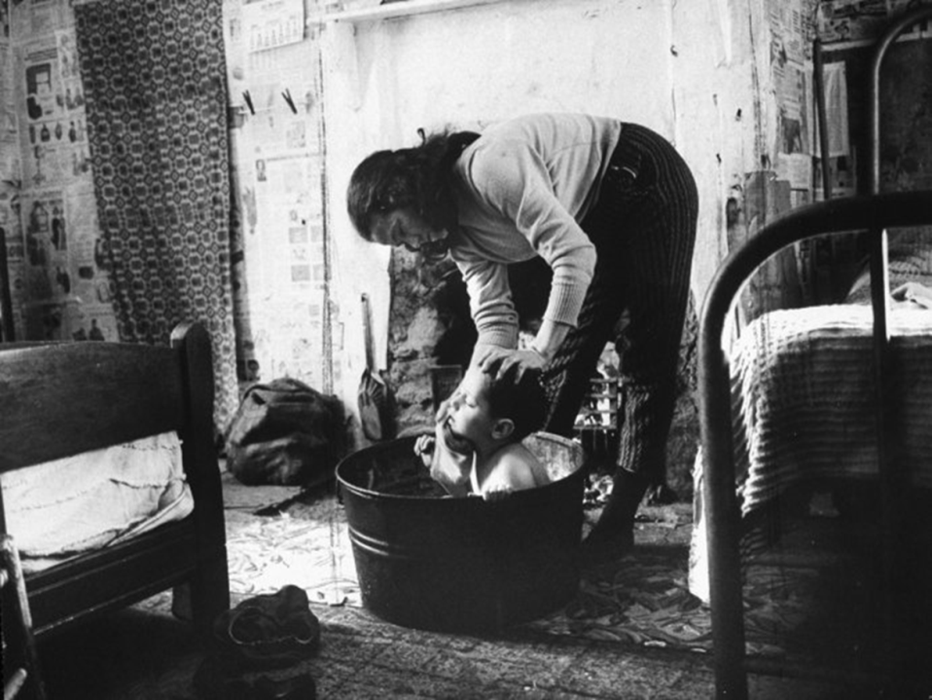

Slide 14


Slide 15
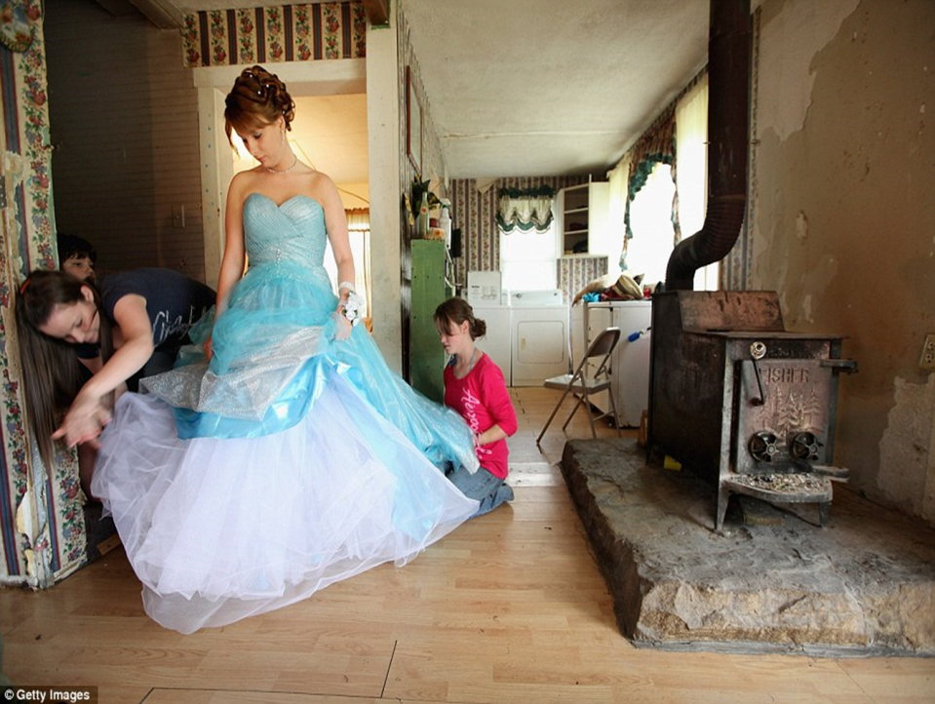

Slide 16


Slide 17
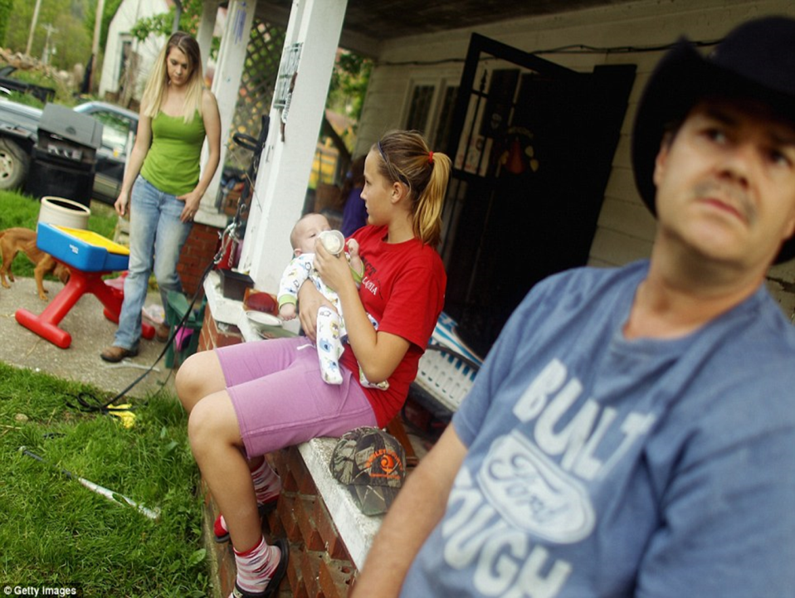

Slide 18
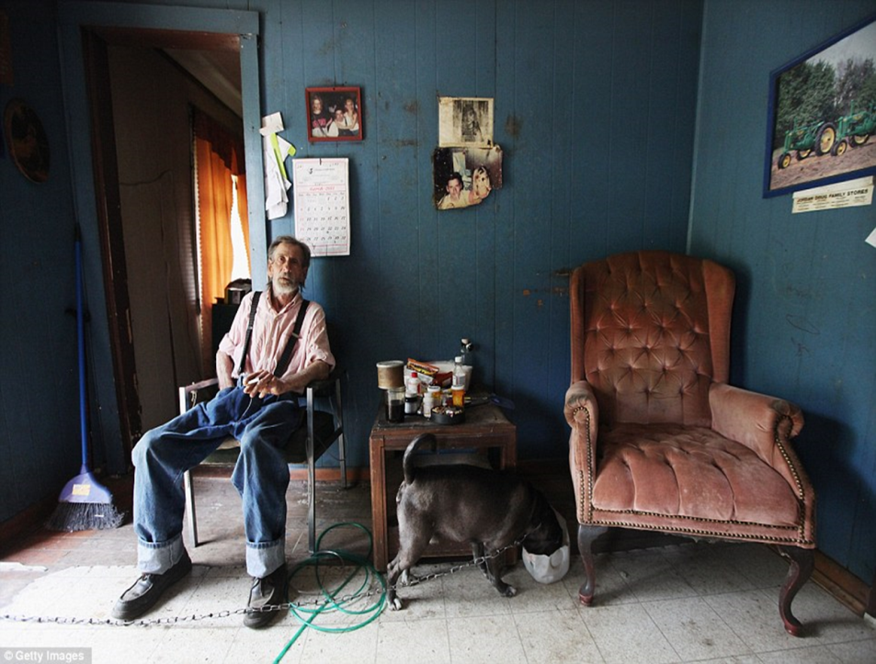

Slide 19
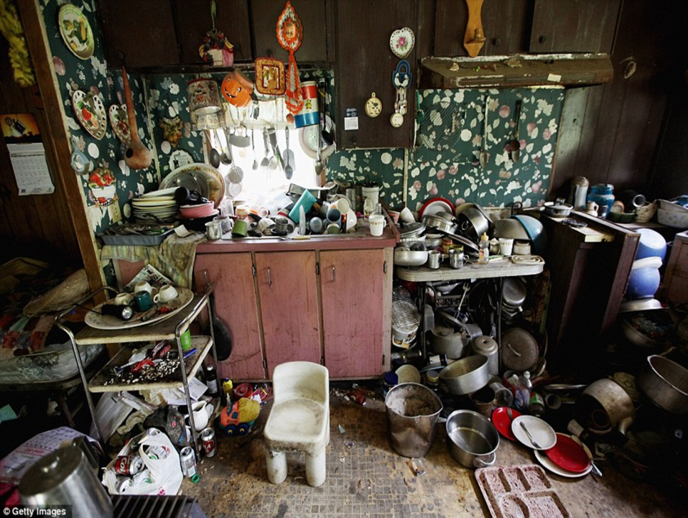

Slide 20
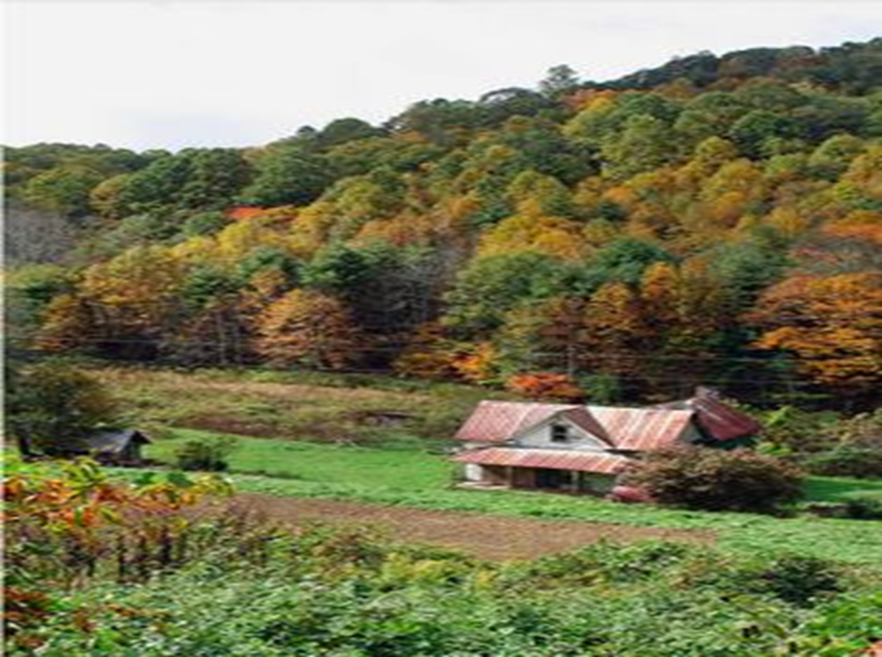

Slide 21
Compelling Questions
Address problems and issues found in and across the disciplines;
Require students to apply to disciplinary concepts and skills;
Require students to construct and argument;
Compelling questions emerge from students’ curiosities;
Grounded in curriculum and content.

Slide 22
Questions for compelling questions.
Will the question get under kids’ skin?
Is it interesting?
Is there a way to engage students in this question?
Is the question full of curricular jargon? Is the question vague or obtuse?
Is there bias? Is there room for argument?

Slide 23
Examples of compelling questions.
Am I rich?
What color am I?
Does the color of our skin matter?
Why do we have rules?
Why can’t I say that?
Why are we still reading Lincoln?
How bad was the recession?
Where are we?
Can the US and Canada be friends forever?
Why is Frankfort the capital of Kentucky?
Who won the Cold War?
Was the Civil Rights Movement of the 1960’s a success?

Slide 24


Slide 25
Supporting Questions
Contribute to an understanding of a compelling question;
Focuses on descriptions, definitions and processes;
General agreement in the field;
Require students to construct an explanation;
Grounded in curriculum and content.

Slide 26
Questions Examples
Compelling Question:
  Was the American Revolution Revolutionary?
    Supporting Question:
      What were the regulations placed on the colonists under the Townshend Acts?

Slide 27
Questions Examples
Compelling Question:
  Should our community grow?
    Supporting Question:
      Who are community helpers?

Slide 28

Back to the question sandbox……

Slide 29

Revisiting - Understanding Clear Academic Achievement Standards
Notes:
“Ten Assessment Competencies for School Leaders” in Assessment Balance and Quality: An Action Guide for School Leaders by Chappuis, Commodore & Stiggins
Addressing the need to understand clear academic achievement standards to … in the future… create aligned classroom-level achievement targets, and their relationship to the development of accurate assessments.

Slide 30

12:00 – 12:45 p.m.

Slide 31

June 16th OR 17th
Notes:
Planning Exercise

Slide 32


The expectation is that social studies teachers will leave the work session with knowledge of a process to evaluate social studies curricula and also a tangible product that exemplifies highly effective teaching and learning focused on the key shifts of the proposed Kentucky Academic Standards for Social Studies.
Notes:
Carole 12:45 – 1:00
Refer to handout

Slide 33
Social Studies Summer Work
Dates by Districts:
Tuesday, June 16th
9:00 – 3:30 p.m.
Wednesday, June 17th
9:00 – 3:30 p.m.
Breathitt
Floyd
Harlan
Hazard Ind.
Jackson Ind.
Jenkins Ind.
Knott
Lee
Letcher
Leslie
Magoffin
Middlesboro Ind.
Owsley
Paintsville Ind.
Perry
Pike
Pikeville Ind.
Wolfe
Hazard Community and Technical College
First Federal Building: Ballroom

Slide 34


Social Studies Summer Work Session
https://docs.google.com/forms/d/175wYeaWAZJ8Vg7RBVvPKtliNsvr2nH8OxsmGtmejyeI/viewform?c=0&w=1
Deadline to Register is June 5, 2015!
For Questions Contact:
carole.mullins@hazard.kyschools.us

Slide 35

Alfonso De Torres Nunez, KDE World Language Consultant

Slide 36



Power UP
Teaching and Learning
with icurio!
KVEC Social Studies Teacher Leader Network
May 15, 2015
Carole Mullins, Literacy Instructional Specialist
Carole.mullins@hazard.kyschools.us
Notes:
Carole

Slide 37



What is icurio?
Digital Learning Resource Library that is easy to navigate and can be utilized by teachers, students and parents when appropriate.
Icurio delivers a dynamic collection of over 330,000 vetted, contextualized, standards-aligned digital learning resources from a broad range of content providers.
  Includes a guaranteed that each resource in the Library has cleared a 127-point certified vetting process and is expertly tagged according to: resource type, language, authority and subject depth, alignment to relevant standards, grade level, readability score and up to 57 defining characteristics.
Notes:
Carole
Handout: What is icurio!

Slide 38
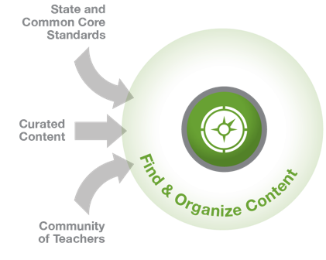
The Right Content
Icurio is a central point for Administrators & Educators to search, save & share digital content resources aligned to KY Core Academic Standards.
Users can share resources and/or folders across individual users, the School and/or the District.
Via My Content, it allows Teachers to customize the resources/folders best suited to their students.
Accessible to Students & Parents.
Notes:
Carole
With icurio educators have the ability to…

Slide 39

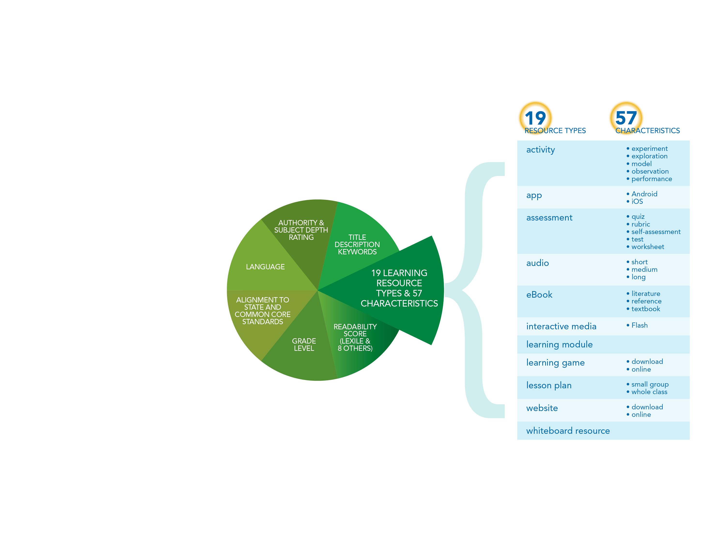


Tagged resources so
they are easy to find
Notes:
Carole
With icurio educators will know that…
Each resource is tagged according to 19 different learning types and 57 characteristics. This way, teachers and students can quickly and easily find just what meets their teaching or learning needs – in exactly the format they need.

Slide 40

Sample Content Providers, and Thousands More!
KEY POINT: Via Single Sign On, SAS Curriculum is incorporated into icurio !
Notes:
Carole
This is just a sample of the most known content providers we have in the library, but we also curate content from thousands of powerful sources you’ve haven’t experienced yet.

Slide 41
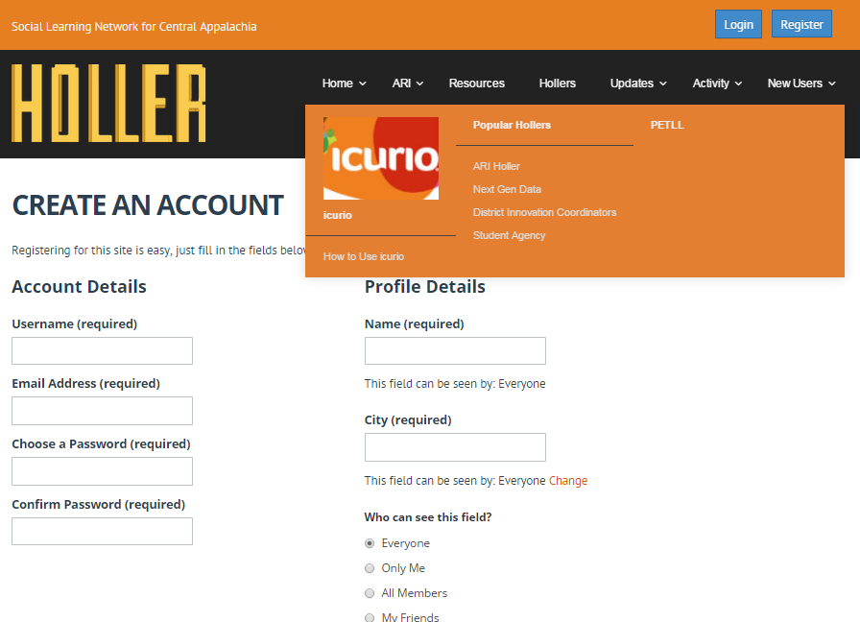
Access Point
Go to www.theholler.org
Click on the ARI dropdown
Click on the icurio icon to login
Notes:
Per KVEC, icurio link is accessible from theholler.org

Slide 42
Access Point
Once you create a HOLLER account and join the icurio HOLLER, many support resources and
on-going updates are available.
Be sure to visit OFTEN to receive the
most up-to-date information!
Notes:
Promote use of the HOLLER…

Slide 43
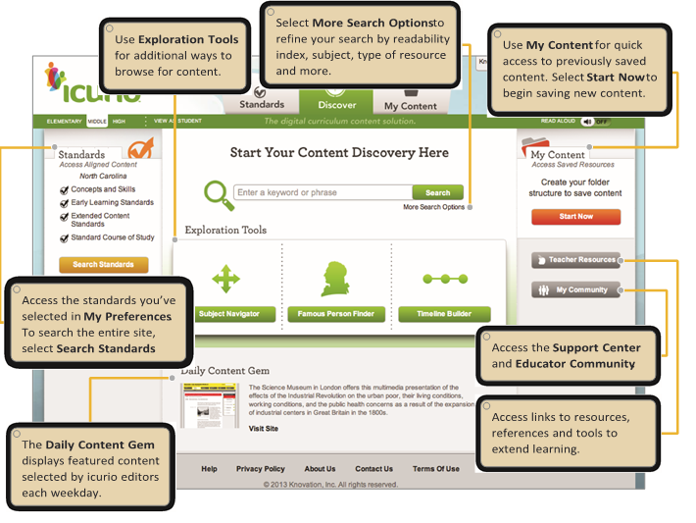
Let’s Get Started…
Quick Reference Guide
Notes:
Handout: Quick Reference Guide
Lead participants through icurio experience

Slide 44
How does this resource address rigor in Kentucky?
.
Kentucky Academic Standards
  Readability
Assessment
Kentucky Framework for Teaching
Notes:
Why icurio is a better resource than google!
Standards tabs (discuss removal of old standards)
Explain readability

Slide 45
KVEC/ARI LEARNING TOPICS
What is the connection to ARI?
Personalized and Blended Learning
Future Ready Learners
Early Literacy
STEM
Reading, Writing, Listening and Speaking
Notes:
Handout: ARI Grant Learning Topics
Participant Activity involving ARI Learning Topics

Slide 46

Personalization
Jeopardy
http://jeopardylabs.com/play/search-results-refinement
Notes:
Carole

Slide 47

Notes:
Q and A

Slide 48
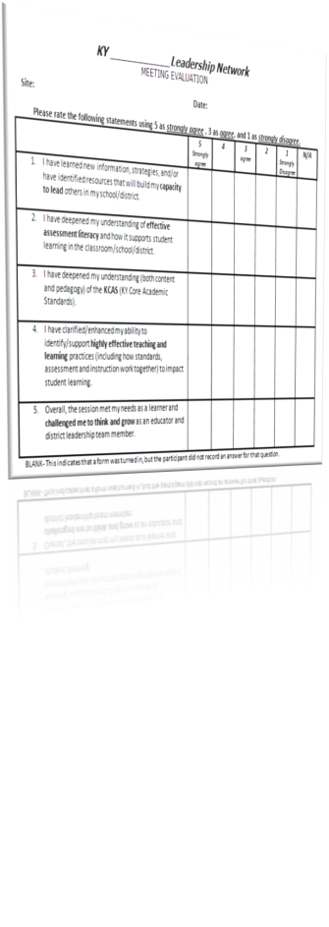
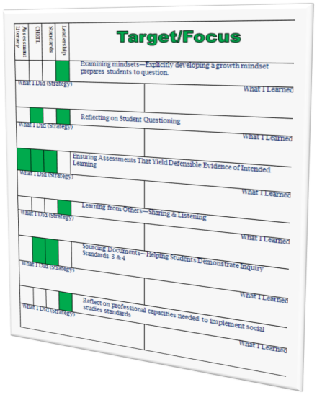
Unpacking Your Day
Notes:
Evaluations and Certificates

