Slide 1
Questions that matter in the social studies classroom.
Crafting
Notes:
Kim:
Now that we have a better understanding of QFT, let’s start thinking about what it could look like in our classrooms.
Effective Inquiry Practices should begin with questioning. This practice sets out a vision that students and teachers would be co-constructing questions suitable for inquiry.
While students would be asked to practice writing questions, we know that teachers’ questions will likely guide curricular decisions.
What is CRUCIAL IS THAT STUDENTS UNDERSTAND THE QUESTIONS UNDER INVESTIGATION
Questions can’t live on a whiteboard or up on a wall or worse, in just a lesson plan—these questions cannot be ornamental, but rather they need to live in the classroom.
The hope or intent is that an instructional space would be created that would allow students to explore the questions and to build a series of questions (supporting questions) to guide the inquiry.

Slide 2
Remembering Pearl Harbor
(Franklin D. Roosevelt Library, NLR-PHOCO-A-8150(29))
Notes:
Kim

Slide 3
Notes:
Kim

Slide 4
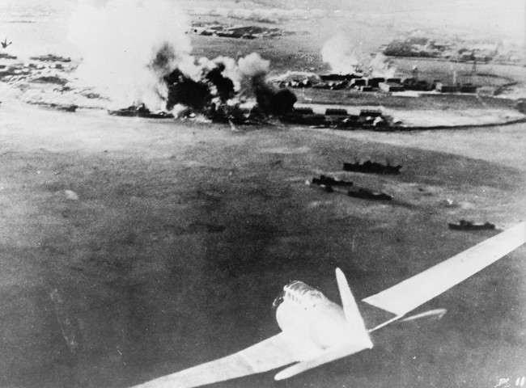
Notes:
Kim

Slide 5
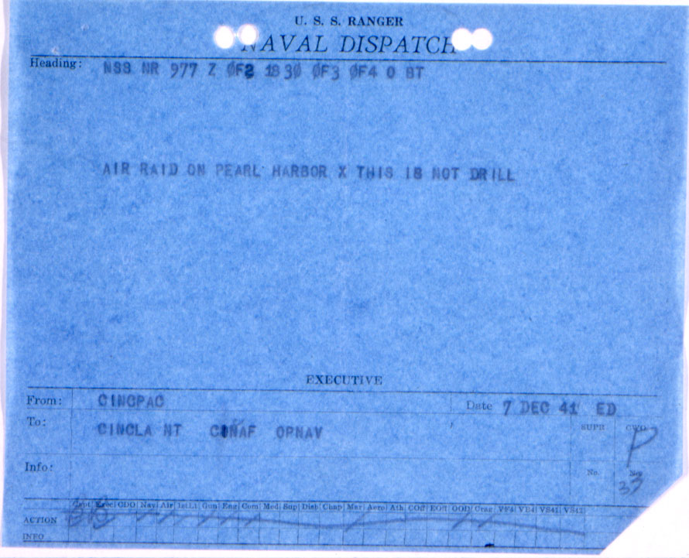
Notes:
Kim

Slide 6
Notes:
Kim

Slide 7
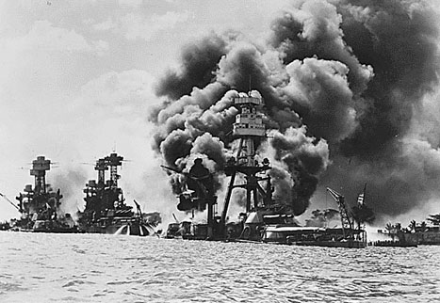
Notes:
Kim

Slide 8
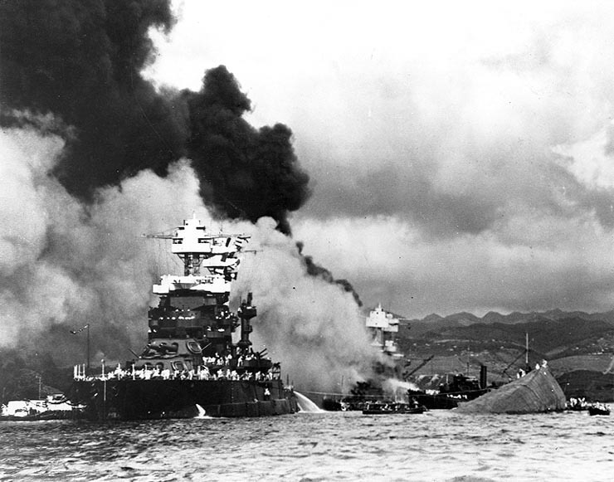
Notes:
Kim

Slide 9
Notes:
Kim

Slide 10
Notes:
Kim

Slide 11
Notes:
Kim

Slide 12
Produce Your Questions
Independently, Ask as Many Questions as You Can (remember the Q-Focus)
Follow the Four Rules
Number the Questions
Notes:
Kim
Follow these instructions:
INDEPENDENTLY: Ask Questions for 4-5 minutes.
TABLE GROUP: Recorder and Chart Paper: Each participant submits questions to be included on the chart
Number the Questions

Slide 13
Improve Your Questions
Take one closed-ended question and change it into an open-ended question. (Divergent Thinking)
Take one open-ended question and change it into a closed-ended question. (Convergent Thinking)
Notes:
Kim
Individually: Follow the directions on the slide

Slide 14
Prioritize Your Questions
Review your list of questions
2. Choose the three questions you consider most important
3. While prioritizing, think about the Q-Focus
Notes:
Kim
Individually: Follow the directions on the slide

Slide 15
Share Your Questions
Your three priority questions and their numbers in your original sequence.
Rationale for choosing priority questions.
THEN:
Create a TABLE LIST of QUESTIONS from your shared priority questions.
Notes:
Kim
Follow the directions on the slide

