Slide 1


Social Studies
Teacher Leadership Network
December 2, 2014
www.kvecsstln.weebly.com
Notes:
9:00 –Carole
WELCOME
Sit in District Teams

Slide 2

Our Target Focus:
Learning from Others: Sharing the QFT Experience with
Reflecting on Student Questioning and the QFT connection to the C3 Framework, KY Framework for Teaching and DRAFT Social Studies Standards
Yielding Defensible Evidence of Intended Learning for Standards 1-3 through the QFT Experience
The power and importance of Professional Learning Communities
Sourcing Documents—Helping Students Demonstrate Inquiry Standards 3 & 4
KY Model Curriculum Framework: Resource to encourage an understanding of the support structures needed to assist in curriculum planning.
Notes:
Carole

Slide 3
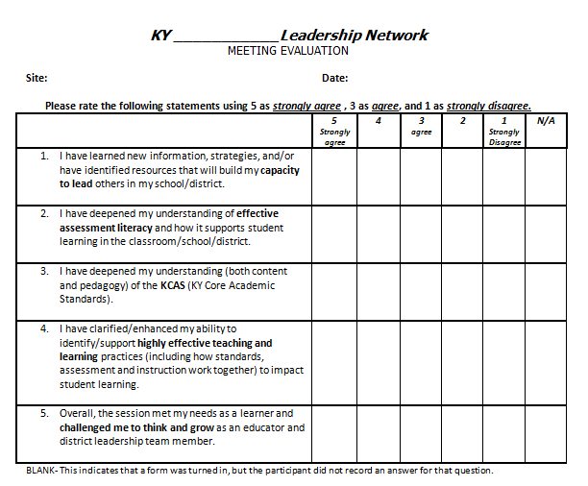
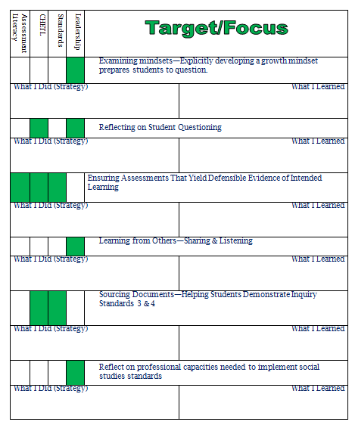
Tracking Your Day
Notes:
Carole

Slide 4
QFT Share-A-Thon
Room 1
Grades K-5
Room 2
Grades 6-8
Main Room
Grades 9-12
Notes:
Carole
Divide into grade level groups for QFT Share-A-Thon : Facilitators refer to notes on Process Agenda

Slide 5
Why is QFT an effective instructional
strategy for Social Studies?
MAKE THE CONNECTIONS
Notes:
Grade Level Group Facilitator: Facilitators refer to notes on Process Agenda
Discuss with table group and jot connections in journal

Slide 6

10:30-10:40
Notes:
Break:
Draw for Eggspert

Slide 7

Professional Learning Networks
What is a PLN?
What can you do to become more connected?
https://www.youtube.com/watch?v=hLLpWqp-owo#action=share
https://www.youtube.com/watch?v=K4Vd4JP_DB8#action=share
Notes:
Missy
As you watch the videos, use the learning organizer to document your key learnings and questions.
What is a PLN?
https://www.youtube.com/watch?v=hLLpWqp-owo#action=share
Connected Educators
https://www.youtube.com/watch?v=K4Vd4JP_DB8#action=share

Slide 8

The Power of the PLN
During reading and discussion, use the learning organizer to note
Read the blog post.
Engage in discussion with a connected educator
Key learnings
Questions

Slide 9
Social Studies Standards:
UPDATE
KVEC SSTLN January 27th Meeting Cancelled (Feb. and March will still meet!)
Social Studies Network Summer Meeting Dates:
  June 16, 17, 18, 2014
  Focus: Curriculum Alignment for new Social Studies Standards
2015-2016 Projected Implementation
Notes:
Carole

Slide 10
As of Nov. 24, 1,184 responses to the survey on the Social Studies Standards have been received:
About 58% of responders identify themselves as current KY Social Studies teachers, 37% as parents, 29% KY citizens, and 19% KY teachers, not Social Studies (Respondents can choose multiple descriptors).
The range in AGREEMENT—meaning that respondents said the proposed standards are good as they are - is 74%-90% with an average right around 80%.
Of those that report revisions are needed, only a small percentage (around 10-15%) actually propose a change.
Many of the comments speak of a concern about assessment, need an explanation of terms, or provide information on what supports/curriculum resources would be desired.
Overall nothing has been asked/suggested that wasn’t already revealed in our focus groups with approximately 600 educators/stakeholders.
KDE is working to address all concerns.
Notes:
Two issues that are critical to the success of schools/districts:
Ability of schools/districts to build a systemic professional learning plan for the building and implementation of curricula based on new social studies standards.
Deepening the understanding of all educators regarding assessment literacy—particularly realizing the appropriate and defensible uses of summative and of formative information, including necessary skills and competencies needed by all educators to enact a strong, balanced assessment system that yield actionable and defensible evidence of student learning.

Slide 11

LUNCH
12:00 – 12:45 p.m.
K-4 Teachers Report to Breakout Room After Lunch
Notes:
Carole
K-4: Move to Breakout Room After lunch
Draw for Prize

Slide 12
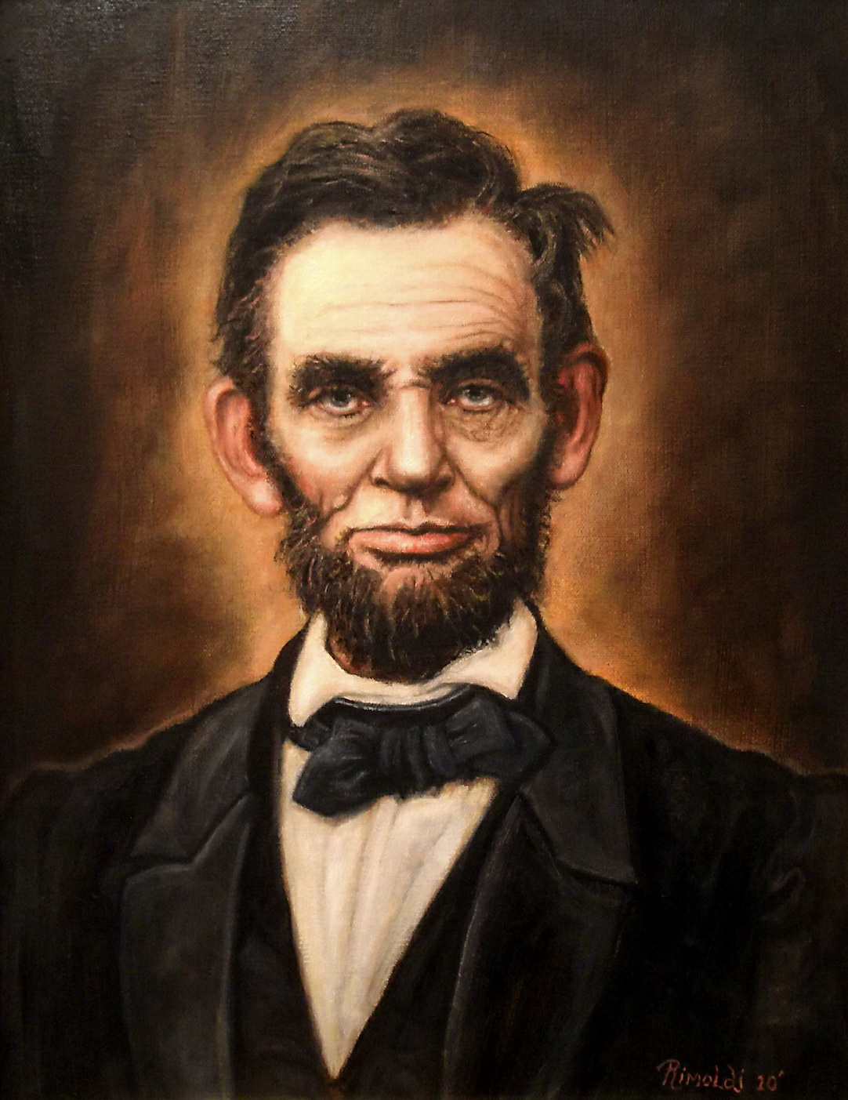
Sourcing:
Abraham Lincoln
Man vs. Legend
Notes:
12:45-1:45
Jennifer (5-12) “Man vs Legend”
Mary (K-4)

Slide 13
What is Sourcing?
Sourcing asks students to consider who wrote a document as well as the circumstances of its creation. Who authored a given document? When? For what purpose?
When reading a document, students would ask questions such as:
• Who wrote this?
• What is the author’s perspective?
• Why was it written?
• When was it written?
• Where was it written?
• Is this source reliable? Why? Why not?
Notes:
Jennifer
Although typically used to examine primary documents of all types, sourcing can be used to increase student access to the daily newspaper, the textbooks on your shelves, a song, the evening TV news or even a work of historical fiction.
By increasing access, we mean understanding in a way that allows critical discussion and evaluation of the source itself as well as its value to the research.
That being true, it's obvious that this questioning routine would be valuable as you examine any source of information in your classroom.
In answering these questions about any and all resources, you are inviting your students to engage in the close reading so essential to understanding difficult text. This leads to a richer discussion and deeper comprehension.

Slide 14
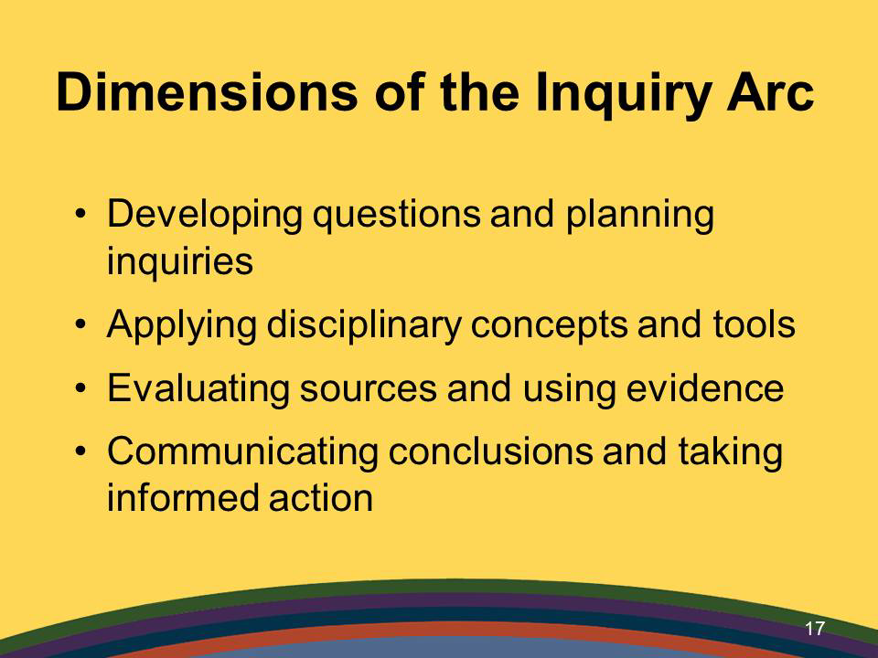
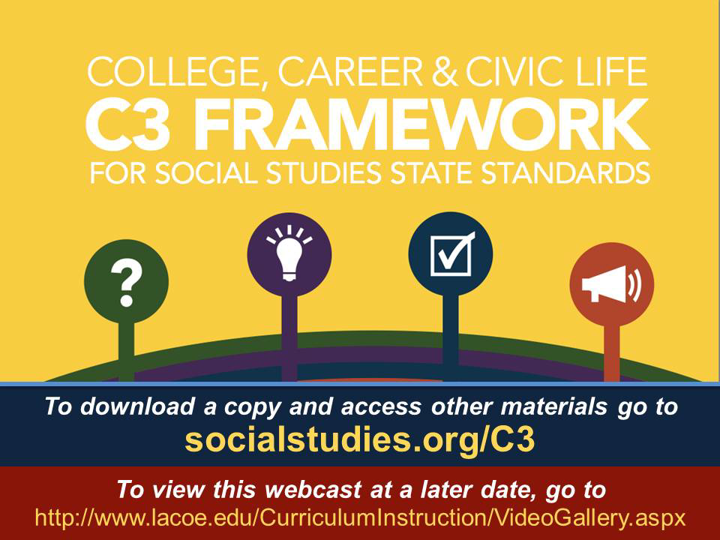
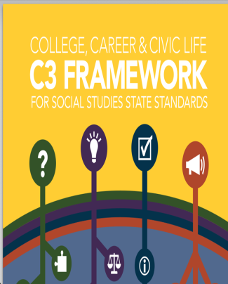
Notes:
Jennifer
Evaluating sources and using evidence is one of the dimensions of the Inquiry Arc. This is an important enduring skill and it is a skill that students need support in learning.

Slide 15

DIMENSION THREE: Evaluating Sources and
Using Evidence
Gathering and Evaluating Sources
Developing Claims Using Evidence
Notes:
Jennifer
Dimension 3 is about gathering and evaluating sources and using evidence in developing claims

Slide 16
By the end of the eighth grade, Students will…
“Gather relevant information from multiple sources while using the origin, authority, structure, context and corroborative value of the sources to guide a selection.”
“Evaluate the credibility of a source by determining its relevance and intended use.”
“Identify evidence that draws information from multiple sources to support claims, noting evidentiary limitations.”
“Develop claims and counterclaims while pointing out the strengths and limitations of both.”
Notes:
Jennifer
The C3 framework defines that by the end of the 8th grade, students should be able to do these things.
Essentially, students will be able to determine whether or not a source is reliable. They will determine whether information from the source is relevant to the topic. They will compare information from multiple sources and use the information to form claims and counterclaims.
Is this rigorous, complex thinking that students haven’t been asked to do before? Yes.
Are these the types of skills we as students weren’t developing until late high school and college? Yes.
Will these skills better prepare them for life? Yes.
Has every 8th grade student’s brain developed to the point of mastering these skills? No. (You’ll have to keep talking to lawmakers about that one!)
Will challenging students to master this skill hurt them any? No.

Slide 17
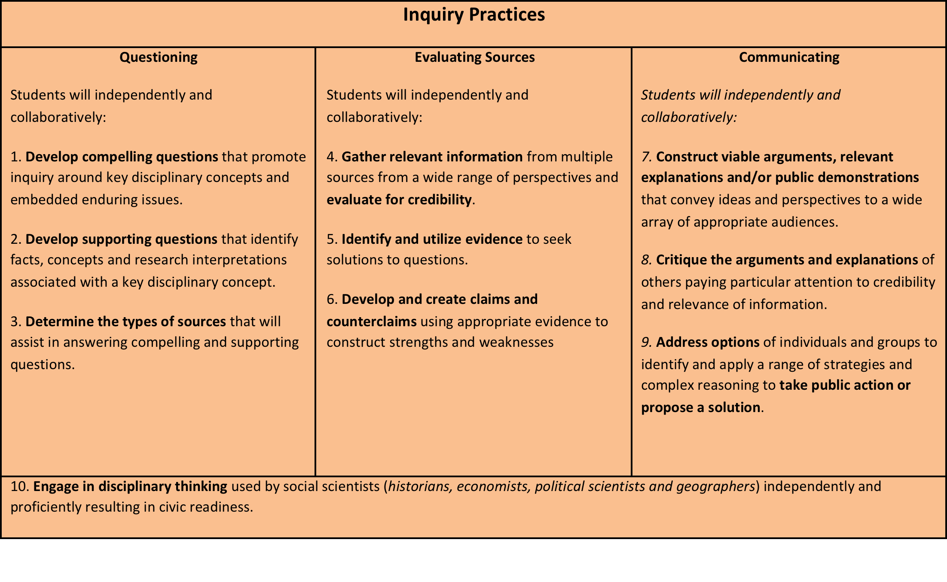
Notes:
Jennifer
In addition to the clear connection to the C3 Framework, we can also identify the same types of connections to the Draft SS Standards for the Next Generation

Slide 18
Draft Social Studies Standards for the Next Generation
8.HT.13 Historical Understanding: Contextualization and Perspectives Analyze how people’s perspectives and multiple factors influenced what information is available in the historical sources they created, explaining how and why perspectives of people have changed over time.
8.HT.14 Historical Arguments Organize applicable evidence into a coherent argument including the examination of claims in *historical and multimedia sources.
8.HT.15 Interpretation and Synthesis Evaluate the relevancy and usefulness of a historical source by examining and detecting possible limitations based on evidence collected from different kinds of historical sources.
Notes:
Jennifer
Just pulling out the 8th grade standards in Historical Thinking, you can clearly see the connections between sourcing and what the Standards define for our students.

Slide 19
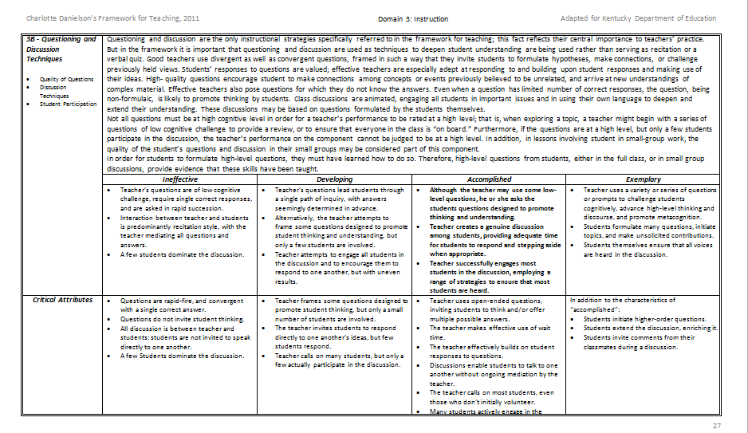
Domain 3: Instruction
3b – Questioning & Discussion Techniques
Notes:
Jennifer
Sourcing is grounded in questioning which we looked at in the KY Framework for Teaching at our last meeting.

Slide 20
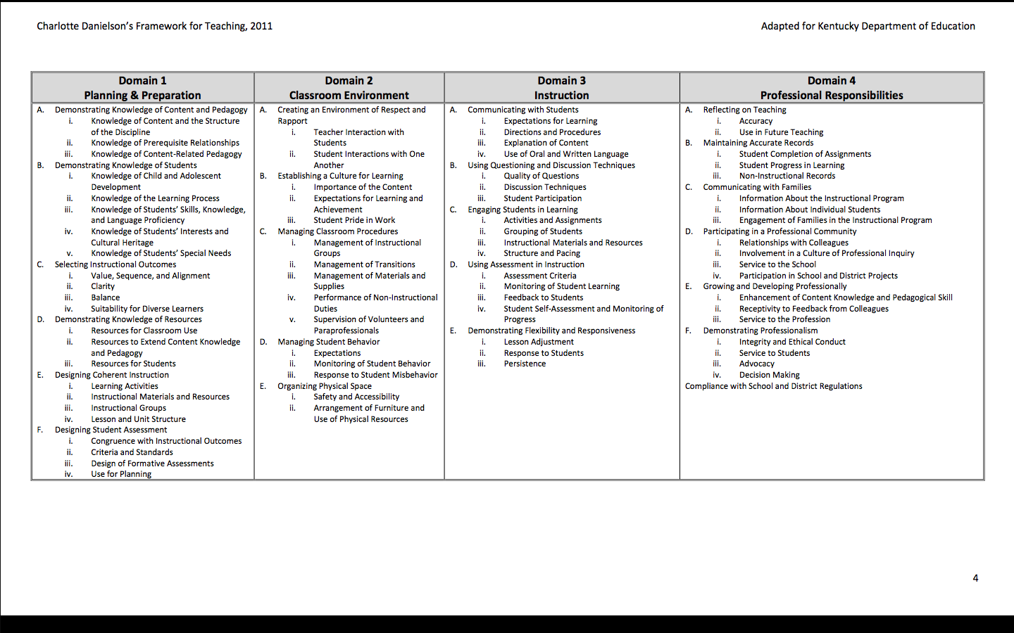
Notes:
Jennifer
Domain 1
Demonstrating Knowledge of Content and Pedagogy,
Demonstrating knowledge of resources (resources for classroom use, resources ot extend content knowledge, resources for students)
Designing coherent instruction, instructional materials and resources
Domain 3, again Questioning and discussion techniques and engaging students in learning.

Slide 21
Notes:
Jennifer
This chart breaks down historical thinking skills involved in sourcing. When sourcing documents, the first level of questioning is about the first layer of the document…who wrote it, what was the perspective of the author, when was it written, where was it written, why was it written, at first glance is it reliable?
Then, we delve deeper into the documents…Understanding where and when the document was written or created, we can analyze what was different then, what was the same and how the circumstances in which the document was created might influence its content.
Once we truly understand a document as it stands by itself, then we can look at it next to other documents. How does it compare to other documents, are they in agreeement, what other documents do we need to consult, of the documents we are looking at, which are most reliable?
Then finally, we have to really analyze what the authors of the documents say….what are the claims, what is the evidence, is it reliable? Does the author use language to get the reader to agree with the content or is it really supported with evidence….
This framework can help students with the sourcing process by providing them with look fors and questions to address in their thinking and analysis.

Slide 22
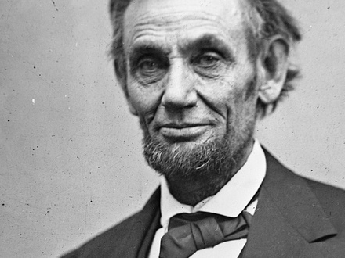
Trying it out…
Abraham Lincoln:
Man Vs. Legend
Notes:
Jennifer (Grades 5-12)
In this lesson, students interrogate their own assumptions about Abraham Lincoln in order to arrive at a deeper understanding of who Lincoln was.
They investigate primary source documents in order to analyze the elements of Lincoln’s life that have become legend and those that have been forgotten by history.

Slide 23
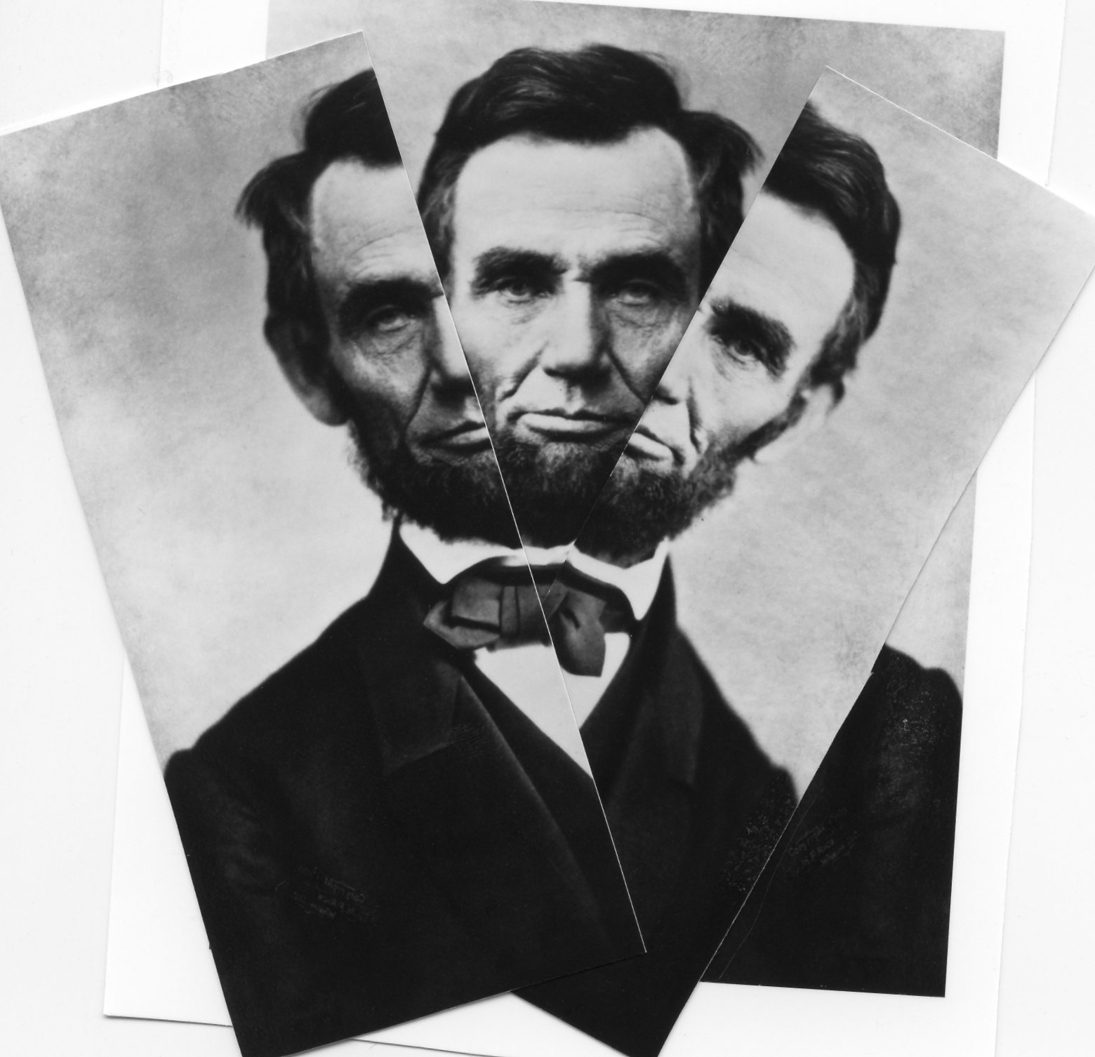
Learning Target for Lesson:
Students will investigate primary source documents in order to analyze the elements of Lincoln’s life that have become legend and those that have been forgotten by history.
Notes:
Jennifer
This lesson is written for grades 9-10, but can be adapted for use in grades 6-12.
For middle school grades, the ink shedding activity can be simplified by reducing the number of documents students investigate and/or assigning students to work in pairs. The primary source material can also be made more accessible by highlighting the important information.
For grades 11-12, lesson can be made more challenging by asking students to conduct further research into the personal life of Abraham Lincoln and/or the inner workings of his administration. See “Document Collection: Optional Sources for Extensions” under the “Materials” heading below.

Slide 24

What immediately comes to mind when you hear the name “Abraham Lincoln”?
How did you learn these details?
Notes:
Jennifer
Journal some answers to these questions, thinking about the sources for the information we have learned about Abraham Lincoln.
As you write about this, you might also want to think about what knowledge your students might have about Abraham Lincoln and where they might have obtained that information.

Slide 25
Lincoln: Early Views
Take notes on info you learn about Abraham Lincoln
http://www.pbslearningmedia.org/resource/bf10.soc.7-8.divreun.breaksout.earlyview/lincolns-early-views
Notes:
Jennifer
http://www.pbslearningmedia.org/resource/bf10.soc.7-8.divreun.breaksout.earlyview/lincolns-early-views/
The video discusses the difference between Lincoln’s historical actions and views regarding slavery and how American history often depicts him. After the video, have students discuss what they already know about Abraham Lincoln and what they learned in the video.
Create a mind-map on the white board/SmartBoard to take notes as the students share their ideas. Use the following questions to spur ideas:
What immediately comes to mind when you hear the name “Abraham Lincoln”? (freed the slaves, Emancipation Proclamation; Civil War, saved the union from dissolution, Gettysburg Address; stove pipe hat and black suit, log cabin; Lincoln memorial; Lincoln Douglas debates)
How did you learn these details? (history class, Presidents’ Day lessons, history textbook; just have always known; trip to Washington, DC; pop culture, such as movies, TV or literature)
Ask students to define the terms “symbol” (an object or image that represents an idea or another object) and “legend” (a famous or important person who is known for doing something extremely well). Then ask if the portrait the class has sketched of Abraham Lincoln sounds closer to legend or to a living human being?
How is a human different from a legend or a symbol? (A real human is flawed and complex, and a symbol or legend is one-dimensional and larger than life. Sometimes we create a one-sided picture of historical luminaries and turn them into legends. Popular accounts overlook details that might give a more complete portrait of a person.)
What does Abraham Lincoln symbolize in American history? (Liberty, freedom, the American spirit)

Slide 26
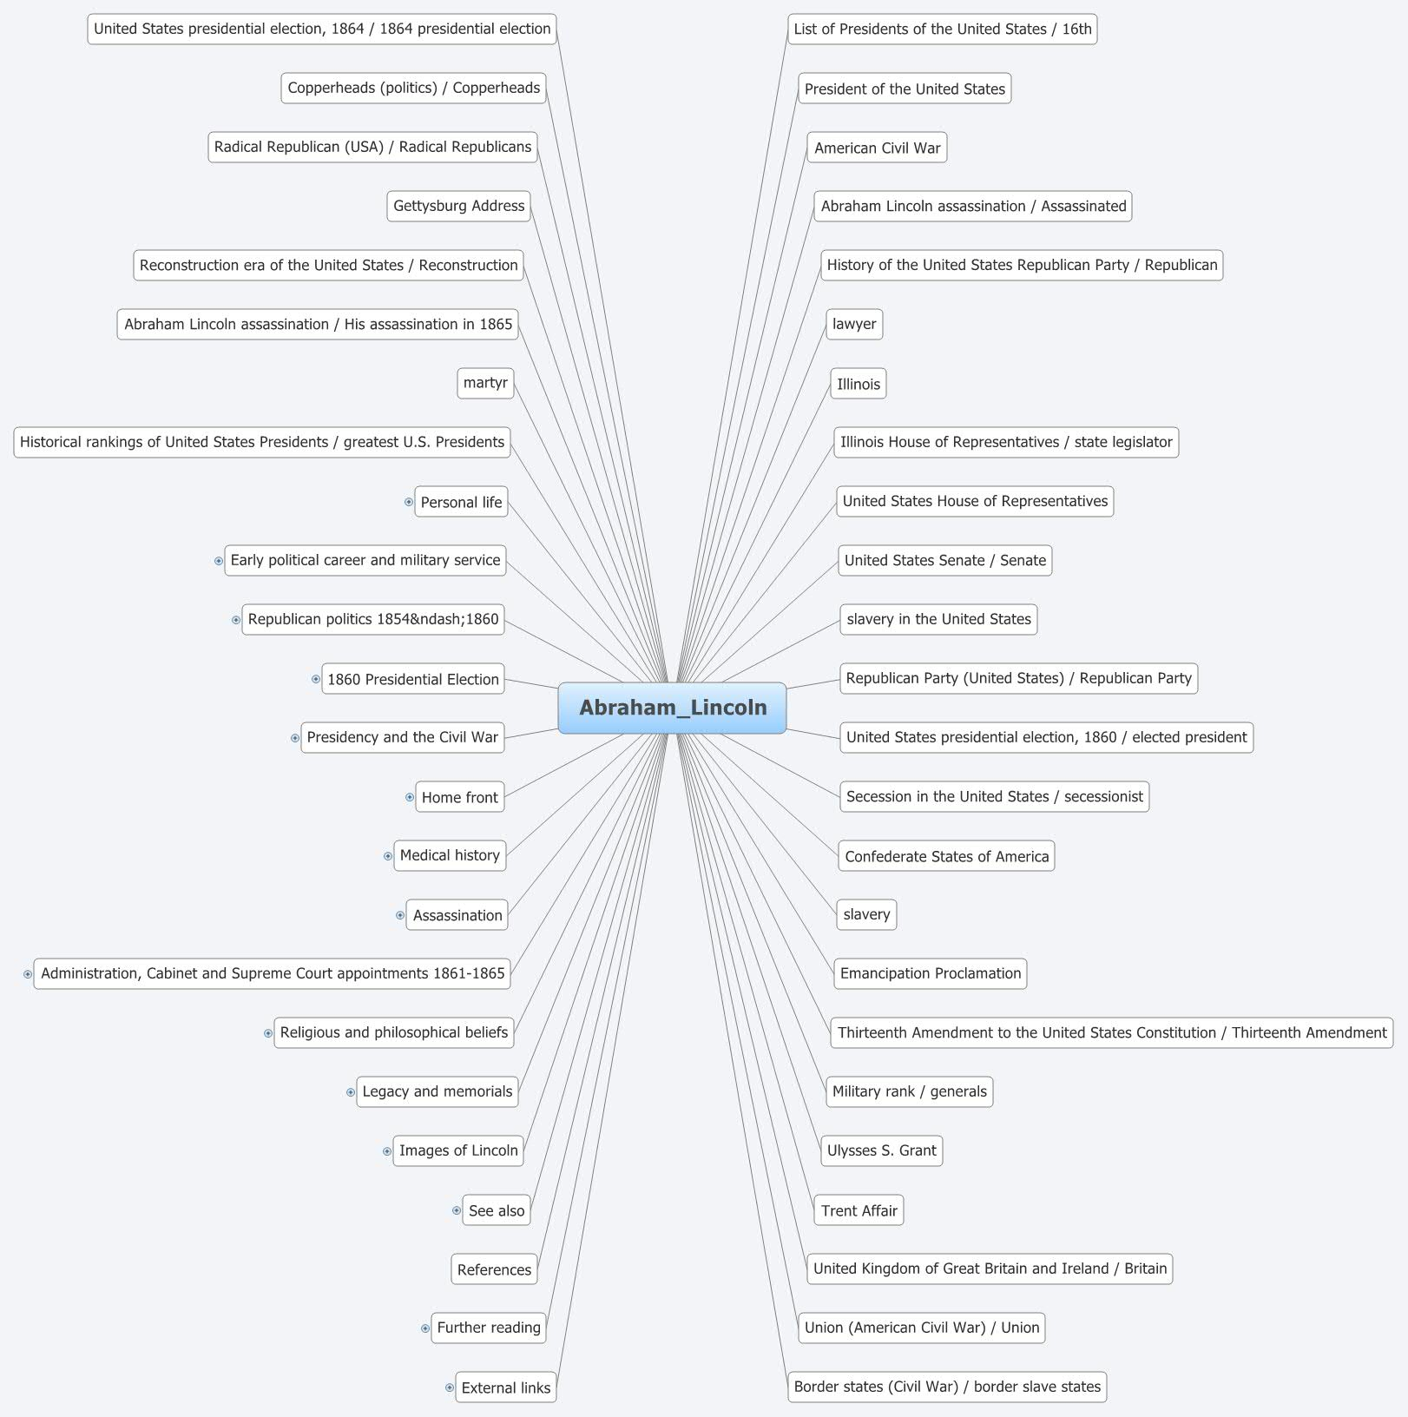
Notes:
Jennifer

Slide 27
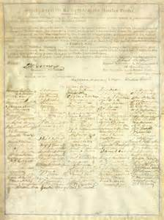
Looking at Sources
1. Visit each station
Sourcing: Who made this source? Where did it come from?
Contextualizing: Imagine the setting surrounding this source: How was the world that made this source different than our own?
Corroborating: What do other sources say about the information in this document? Do they agree or disagree with what this document says?
Close Reading: What does the document say? Is it biased? What is the tone?
2. Review the source at the station
3. Make comments on the chart about the document, what you learn about Lincoln, comment on statements left by peers, etc.
Notes:
Jennifer
Explain to participants that they will be examining primary sources related to the life of Abraham Lincoln through an inkshedding activity.
The purpose of the activity is to uncover the reality of Abraham Lincoln and tell a more complex story of his life by adding details to what they already know from history classes and American media and pop culture.
students will visit various document station at their own pace. While at each station, they read the central document, write a comment or question about that document on the poster paper (or on a sticky note) and stick it to the poster paper. They then read and respond in writing to their classmates’ comments and questions that are already on the poster. Students’ responses to their classmates can be as simple as an exclamation point next to an interesting point or as complex as a response of a couple sentences.
Step 1: Visit Document Stations
In an inkshedding activity, students will visit various document station at their own pace. While at each station, they read the central document, write a comment or question about that document on the poster paper (or on a sticky note) and stick it to the poster paper. They then read and respond in writing to their classmates’ comments and questions that are already on the poster. Students’ responses to their classmates can be as simple as an exclamation point next to an interesting point or as complex as a response of a couple sentences.
The documents students will study are:
The 13th Amendment of the United States Constitution: declares slavery illegal in the United States; signed by Lincoln
Personal Letter, Abraham Lincoln to Mary Todd Lincoln: tells the story of a “nanny goat” who destroyed the flowers, slept in their son’s bed, and went missing
Photograph, “Antietam, Md. Allan Pinkerton, President Lincoln, and Maj. Gen. John A. McClernand”: Abraham Lincoln, in his black suit and stove pipe hat
Excerpt from Personal Letter, Abraham Lincoln to Jesse W. Fell: a brief autobiography of Abraham Lincoln’s early life
Excerpt, First Lincoln Douglas Debate: Lincoln explains the various solutions to the problem of slavery, including his own feelings which “will not admit” allowing freed slaves to be held as equals to whites
Sourcing: Who made this source? Where did it come from?
Contextualizing: Imagine the setting surrounding this source: How was the world that made this source different than our own?
Corroborating: What do other sources say about the information in this document? Do they agree or disagree with what this document says?
Close Reading: What does the document say? Is it biased? What is the tone?
Near the end of the proscribed time, prompt students to cycle back to stations they have already visited to note any comments their classmates made on their original responses

Slide 28
Notes:
Jennifer
Next, distribute the “Evaluating Abraham Lincoln” reproducible.
Instruct students to pick two documents they investigated during the inkshedding to investigate in more detail. They should pick one document that embodies the symbolic Lincoln and one that represents the real, complex man.
Students should answer the questions on the handout based on their own opinions and the questions and comments their classmates left on the poster during the inkshedding.
Put it all together:
On a separate sheet of paper, write a brief paragraph describing the “real” Abraham Lincoln. Remember: the “legendary” Abraham Lincoln is not necessarily fictional. Your paragraph should include details from many documents—just be sure to contextualize where they came from.
Once students have finished the chart on the reproducible, bring them back together as a whole group.

Slide 29
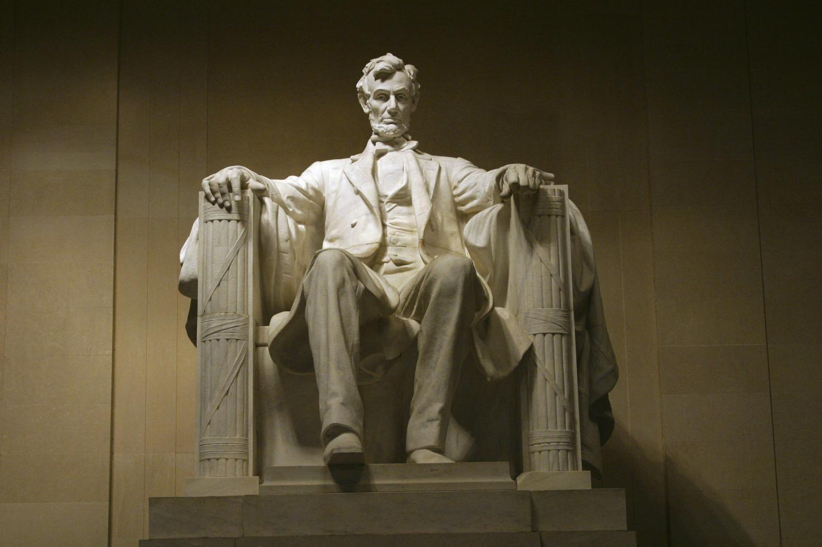
http://video.pbs.org/video/2365250257/
Notes:
Jennifer
http://video.pbs.org/video/2365250257/
Show the video “Abraham Lincoln and Reuben Hatch.” The video shows how Reuben Hatch, a quartermaster in the Union Army, committed serial frauds against the Army, one of which potentially led to the deaths of thousands, and how Lincoln himself enabled Hatch’s continued position within the Army.
After students have investigated the documents and watched the video, ask what they learned about Abraham Lincoln.
We are going to watch a short video to learn more about Abraham Lincoln and if the information we have found about him might influence our perception of him.

Slide 30

Discuss
What documents did you choose to investigate more closely?
What did the documents tell you about Abraham Lincoln?
Was the document biased? In what way?
Did the document tell you something new about Lincoln? Reinforce what you already knew? Contradict something you already knew? Explain.
Did anything you saw in this activity change your opinion of Abraham Lincoln? Why or why not?
Notes:
Jennifer
Discuss these questions at your table

Slide 31
Share paragraphs at your table then choose one to share with the group from your table.
How did viewing primary sources change your understanding of Lincoln? What do they provide that a textbook cannot?
So what? How did this investigation into Abraham Lincoln deepen your understanding of how to look at sources of evidence?
Sourcing and Abraham Lincoln
Notes:
Jennifer
End the class with an opportunity for students to share the paragraphs they wrote describing the “real” Abraham Lincoln. Then lead a brief discussion about why investigations such as this one are important in the study of history.
How did viewing primary sources change your understanding of Lincoln?
What do they provide that a textbook cannot?
So what? How did this investigation into Abraham Lincoln deepen your understanding of American history?
Why is it important to complicate historical stories?
What is the danger in turning history into a legend? Turning a man into a symbol?

Slide 32

How can we check for understanding?
Observations
Collection of student analysis of documents
Teacher questioning of students during independent, small group, or whole group discussion during document evaluation
Student overall evaluation of documents that meets criteria
Student responses that include details about what the author included, did not include, student connections with other background info
Notes:
Jennifer (End at 1:45 p.m.)
Teachers can use observations and collection of feedback from student discussions and also from the actual implementation of the sourcing strategy .
Observations can provide valuable information on how well students identified biases of the author and how they used their background knowledge to critically think about explicit and implicit information and messages in the document.
During independent, small group, or whole group discussions, teacher probing and questioning of decisions and evidence students used to arrive at their document evaluation can provide the teacher with valuable information about students’ thinking.
For assessment purposes, when using the sourcing strategy students should not only include details about information the author
included in the document but also what he or she left out of the document. Students should make connections with other background information related to the topic, such as the time period the document was published and how possibly events during that time could have influenced the author.
Much emphasis should be placed on the evaluation of the document—the criteria students used and their overall evaluation of the document.

Slide 33

1:45 – 2:00
Return to whole group and
sit with your district team.
Notes:
Break 1:45-2:00
Return to whole group. Sit with your district team.
Draw for Eggspert

Slide 34
One issue that is currently critical to the success of schools/districts…
Ability of schools/districts to build a systemic professional learning plan for the building and implementation of curricula based on new social studies standards.
Notes:
Carole (2:00 – 3:00)

Slide 35

Why do we need to revisit the way we design curriculum planning?
Notes:
Carole (2:00 – 3:00) Don’t show entire 5 minute video. Just enough to give teachers the “gist” and identify it as a resource they can use with others in their school/district…
“The premise here is that a new curricular approach should begin with specific rethinking and examination of choices based on the tensions between critical points from our past practice and new challenges for the future…you will be making choices for the generation you are charged to nurture. You are making these choices now…consider these tensions within each discipline, in interdisciplinary connections; in applications for new career possibilities in the future workforce; in the portals between the school, the community, and the globe; in the individual child’s sense of physical and mental well-being; and in the sustainability for our planet…encourage an active target for a curriculum that marries pertinent ideas and purposeful practice-a curriculum that addresses what is essential for our learners.” (Curriculum 21 Essential Education for a Changing World, Heidi Hayes Jacobs, 2010)

Slide 36

How to Use KY’s Model Curriculum Framework
The Model Curriculum Framework includes multiple resources that can support quality curriculum development decisions.
Notes:
Carole
The following slides provide highlights outlining the focus and features of the Kentucky Model Curriculum Framework. This power point serves as an introduction to the Kentucky Model Curriculum Framework 2011.
The Model Curriculum Framework includes multiple resources that can support quality curriculum development decisions.

Slide 37
What is the KY Model Curriculum Framework?
A major resource
Support structures
Example: Think and Apply activities designed as starting points to engage further with the content, processes and supports offered in the KMCF
Notes:
Carole
The Kentucky Model Curriculum Framework provides resources and links to resources that encourage an understanding of the support structures in and outside school needed to assist in curriculum planning.
Curriculum Planning involves a coherent and integrated plan for effective implementation of the curriculum. Consideration of the effective teaching that must occur to ensure learning is happening involves understanding the learner(s), employing instructional strategies and resources that ensure diverse learning needs are met and integrating assessment in an ongoing and systematic way in order to be strategic and purposeful in adjusting the instruction.
Since a child's time “in school” from birth to age eighteen constitutes less than 10 percent of his or her time during those years, the importance of engaging the family and the community cannot be overstated. As a result, our mental model of what “school” looks like is changing. Learning happens 24-7, anytime, and anywhere. So, shifting our mental model of what “school” looks like is required to address the needs of the learner of today who will be the worker of tomorrow.
What does this mean for how the stages of the curriculum planning will occur in your district/school?

Slide 38
Stages of the Work
Curriculum framing
Curriculum writing
Curriculum implementation
Curriculum review
Curriculum evaluation
Notes:
Carole
The Kentucky Model Curriculum Framework is intended to generate discussion of a P-12 curriculum, offer direction for curriculum design with links to resources, and guide the curriculum writing process. The KMCF is offered as the curriculum framing stage of the work.
The curriculum writing stage and all other stages noted in blue are completed at the district and school level.
Updates in curriculum content are at the heart of educators work for learners and for educators own professional development.
You may want to begin thinking about a “phase in” process for the writing stage. Perhaps your district curriculum could be developed following a timeline based on the timed release of the content standards.
For example, you may want to use the Curriculum Framework initially to address English/Language Arts and Mathematics.
Because the English/Language Arts Standards include a section on ELA and Literacy in History/Social Studies, Science, and Technical Subjects it will be wise to start with a Curriculum Writing Team that is cross-curricular. Don’t forget to include out-of-school partners from the community on your team.
The implementation stage involves delivery of the curriculum in time for implementation.
Considering the professional learning opportunities and support materials needed for teachers, principals and others in schools will be essential for moving toward the implementation of the curriculum.
Supports like sample deconstructed standards, the gap analysis tool, and sample pacing guides found in the KMCF will be helpful resources in the writing and implementation stages.
Setting up a curriculum review and evaluation process by teachers and key groups will make it clear that curriculum development is an ongoing process. Identifying and recording issues that need to be taken into account in subsequent areas of curriculum development or revisions to current curriculum documents is a part of the process.
The KMCF will be reviewed and updated annually based on feedback from educators and other stakeholders from across the Commonwealth. The annual update will reflect any changes to the content standards and will stay current with the latest research, technological advances, and professional literature to ensure a relevant and rigorous response to the expectation of students and the professionals who serve them.

Slide 39
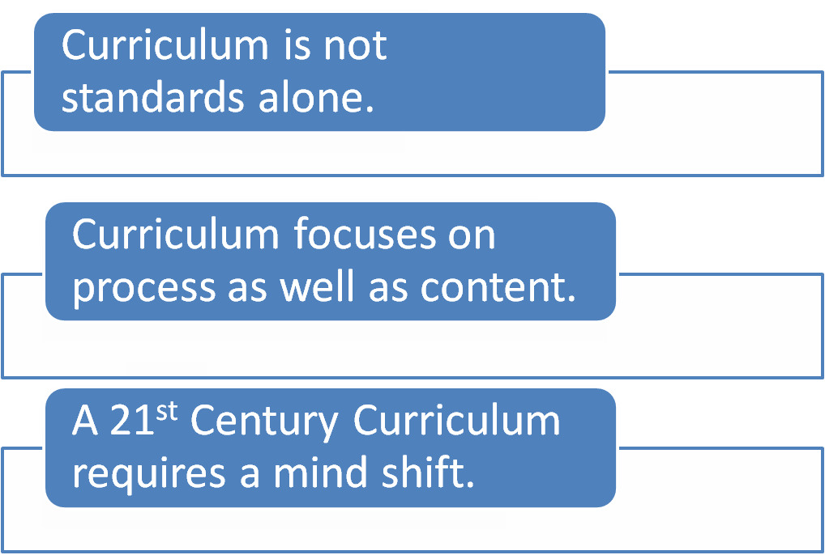
REMEMBER:
Notes:
Carole
Remember:
Curriculum is not standards alone. So, consider the other stakeholders that need to be a part of the process of curriculum writing. For example, out-of-school time partners from community, business, and higher education.
A curriculum framework is an evolving resource that will have continuous development and refinement for it must reflect an understanding and
acknowledgment of the changing nature of the challenges and demands that continue to shape the learner of the future. As we move from what
we are presently doing toward a more 21st century form of education a mind shift is required.
Think and Apply exercises located throughout the KMCF will help lead conversations toward this mind shift.
If we accept that we need to prepare students for a vastly different future than we have known, then our understanding of the focus of education
also needs to shift.
An example: Developing cross-curricular competencies such as managing and monitoring one’s own learning, capacity and predisposition to work together with others in teams, information and communication technologies, and creativity and flexibility of thinking will need to be addressed in addition to cross-curricular perspectives such as cultural sensitivity and respect and engaged citizenship.
There are pockets in KY where this mind shift has begun. The staff in districts and schools are letting go of habits, beliefs and traditions. This is
necessary when we shift mental models of what “school” looks like.
The KY Model Curriculum Framework must include a directory of model sites. So, we encourage schools/districts and others involved in the
process to provide feedback and inform the committee in the coming year about the use of this resource and movement by districts and/or
schools in a 21st century direction.
The KMCF will be updated annually and sharing districts/schools innovative practices and direction with
others is one of the goals of these annual updates to the KMCF resource.

Slide 40
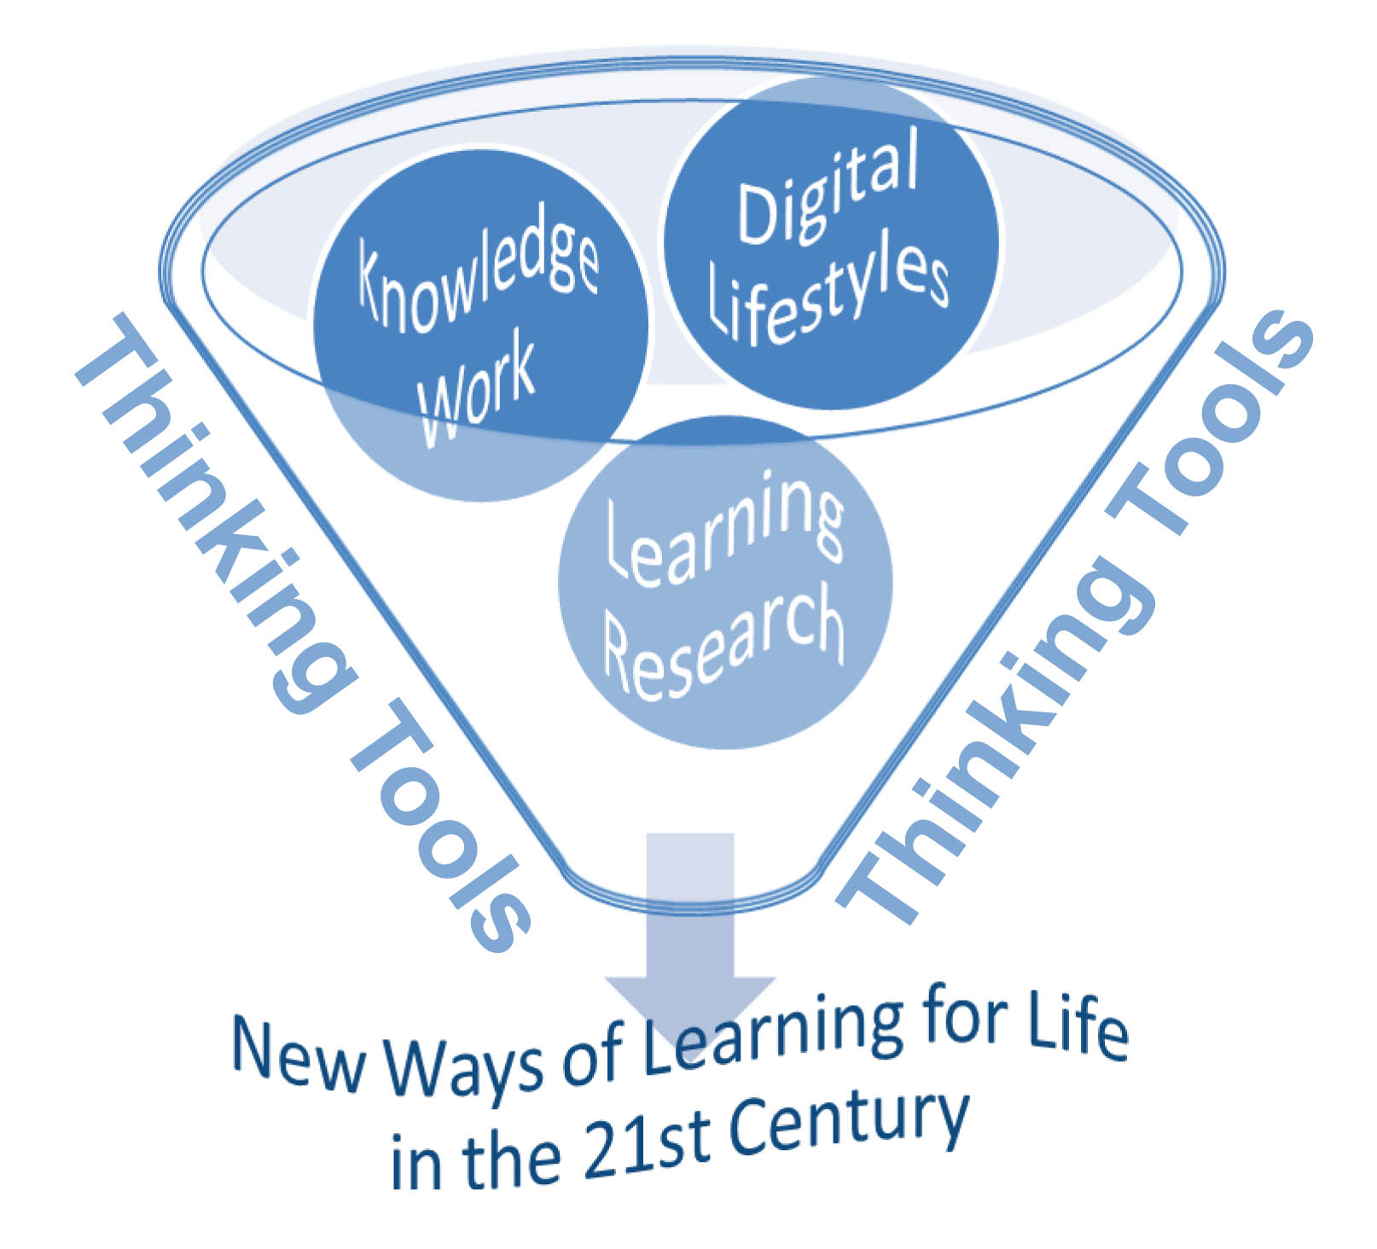
Forces Converging
Changing nature of the challenges and demands of today’s learner and tomorrow’s worker
Reflecting an understanding and acknowledgement of the changing expectations of the learner
Advancing speed of information and communication technologies
Reshaping teaching and learning in response to research in the science of learning
Notes:
Carole
The four statements on the left of the slide are threads throughout the CF resource.
The 21st century knowledge economy seeks knowledge workers and innovators.
Students today have grown up surrounded by digital media and use digital media as their thinking tools.
These young people have different expectations for their learning experiences.
These changing expectations on the part of the learner and the ever growing learning research can be used to direct and guide efforts around curriculum planning and implementation.
As districts and schools work with partners to address the new ways of learning for life in the 21st century these forces are keys to the conversations about the
Changing nature of the challenges and demands of today’s learner and tomorrow’s worker-the 21st century knowledge economy seeks knowledge workers and innovators
Reflecting an understanding and acknowledgement of the changing expectations of the learner-young people today have grown up surrounded by digital media and use digital media as tools for thinking
Advancing speed of information and communication technologies-today’s classroom is not limited by a brick and mortar structure. Connections need to be made locally and can be made across the globe and with experts working in the field of study.
Reshaping teaching and learning in response to research in the science of learning-the ever growing learning research about the brain, motivation and engagement, for example, informs our interaction with learners as never before

Slide 41
Overview of this resource:
Kentucky's Vision for next-generation learners: Students serving actively, productively, and ethically as citizens contributing to the local and global community.
WHAT
set the direction for guiding instruction and learning
WHY
reframe the curriculum in a 21st century context
HOW
guidance for districts/schools in the design of curriculum
Four Powerful Forces Converging
21st Century Student Outcomes and Support Systems
Generating a 21st Century Curriculum Vision
WHY
Planning and Building a 21st Century Curriculum
Action Steps for Design and Review of Curriculum
HOW
Effective Teaching and Opportunities for Learning
Core Subjects and 21st Century Themes
Assessment, Professional Learning
WHAT
LOCAL CURRICULUM
Notes:
Carole
The KMCF is divided into three sections.
The first section is noted in purple and provides the background for why it is necessary to see curriculum design and development as a living and organic process that is continual.
The second section noted in dark blue offers guidance for how to proceed in this continual process of design, implementation, and review.
The last section noted in turquoise contains information on what will be helpful to those working with students both during and outside school time and what the social nature of learning and teaching offers to the experiences of today’s students and educators.
All three…why, how, and what are important considerations when developing the local curriculum.

Slide 42
Table of Contents
Rationale for revisiting curriculum planning
Pages 8-16
Planning a 21st century curriculum
Pages 17-31
Implementing a 21st century curriculum
Pages 32-71
21st century Assessment
Pages 72-77
Professional Learning in the 21st century
Pages 78-84
Rationale for revisiting curriculum planning
Notes:
You see that this is not the typical linear list so often seen in a Table of Contents.
This graphic design is purposeful for two reasons:
we understand districts are at different places in the curriculum design conversation and may choose to enter this resource through different pathways and
the vision for the KMCF is a web-based resource and considering possible web design elements upfront may support this vision in future development and refinement.
Notice how the color scheme matches the information contained in the overview on the previous slide. This will help guide you to the specific pages for the why, how and what of curriculum planning.

Slide 43
KY Model Curriculum Framework
Communicates why reframing the curriculum in 21st century context is needed
Sets the direction for thinking and planning a 21st century curriculum
Sparks discussion about the mind-shift required for guiding instruction and learning in the 21st century
Provides guidance for districts and schools in the design and review of curriculum
Notes:
Carole
The KY Model Curriculum Framework is a resource for use as a facilitation guide by those at the district and school level charged with leading the conversation around curriculum development and design.
The resource assists an instructional supervisor, principal, or teacher leader in providing a rationale for the need to revisit curriculum planning, offering some background information and exercises to generate “future oriented” thinking, and suggesting a process for designing and reviewing the local curriculum.
A survey will be added to the KMCF webpage soon.
After you have facilitated or participated in using the KMCF, return to the KMCF webpage and complete the brief survey. The information gathered from this survey and from districts choosing to participate in feedback sessions with the KMCF Committee will be used in the future annual updates of the Kentucky Model Curriculum Framework.

Slide 44


District Team Discussion
What is the curriculum framework?
How can this resource help my school/students to achieve at high levels?
Why should I lead staff in the use of the KMCF?
How is the Kentucky Model Curriculum Framework relevant to my school?
How do I use this resource as a tool?
Notes:
Carole
Discuss and jot the team’s thoughts in your journal. When finished, give TLs KCMF Page 5.
Compare your team’s thoughts to the information on page 5

Slide 45
Why revisit curriculum planning?
Kentucky Model Curriculum Framework
Page 9
Notes:
Carole
HANDOUT - KCMF Page 9: Allow time for team/group discussion

Slide 46

What conversations need to happen?
What needs to be shared and with whom?
When will we get started?
Between now and February, we will…
Notes:
Carole (End at 3:00)
Handout: What’s Your Plan?
Allow district teams time to begin work on this…

Slide 47
Unpacking Your Day
Notes:
Carole 3:00 – 3:15
Reflection

Slide 48

Remember…
    Turn in your Evaluation
    Get your certificate
    Next SSTLN Meeting is:
24, 2014
Notes:
Carole
Complete Evaluation
Distribute Certificates

