Slide 1


Social Studies
Teacher Leadership Network
October 28, 2014
www.kvecsstln.weebly.com
Notes:
9:00 –Carole
WELCOME

Slide 2

Facilitators
Carole Mullins, Instructional Specialist, KDE/KVEC
Linda Holbrook, Literacy Consultant, KDE
Jennifer Carroll, PGES Consultant, KDE/KVEC
Mary McCloud, Literacy Consultant, KVEC
Dionne Bates, Achievement Gap Consultant, KVEC
Melissa Ferrell, Exceptional Children Consultant, KDE
Paul Green, ARC and KVEC/ARI Consultant
GUEST PRESENTERS:
Kadi Ralston, Instructional Specialist, KDE/GRREC
Teresa Emmert, Instructional Specialist, KDE/GRREC
Notes:
Carole - Introductions

Slide 3

Our Target Focus:
Exploring Student Questioning
Question Formulation Technique– I practice then I do
Connecting Highly Effective Teaching with Questioning
Assessment Literacy and Student Learning
Yielding Defensible Evidence around Inquiry Standards
Identifying Capacities Required to Implement Standards
Notes:
Carole

Slide 4
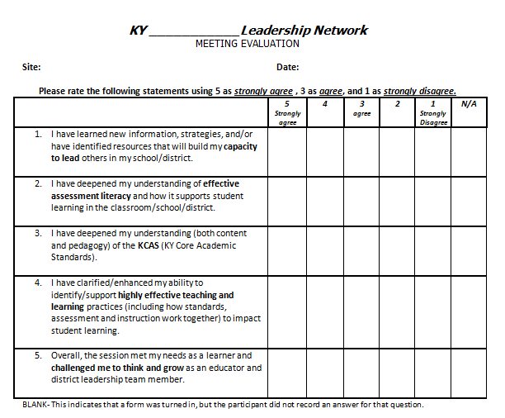
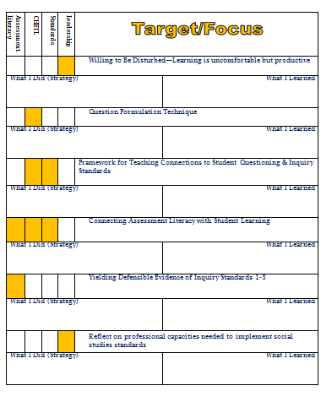
Tracking Your Day
Notes:
Carole

Slide 5

“Willing to Be Disturbed”
Quotation Mingle
After reading the article, take a quote from the envelope on your table. With someone from a different table,
discuss quotes and the two questions below:
When do you feel most uncomfortable professionally?
What in the article made you feel better about being disturbed?
Journal Reflection:
What is the overall takeaway
message from this article?
Notes:
Linda or Carole
LEADERSHIP PILLAR
Read article
Quotes from article will be in envelops on tables
Each person will take a quote, meet with someone from another table and discuss quotes and questions on screen
Return to seat and complete journal reflections

Slide 6
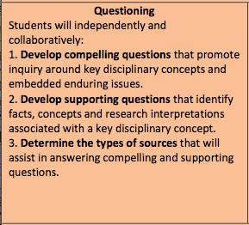
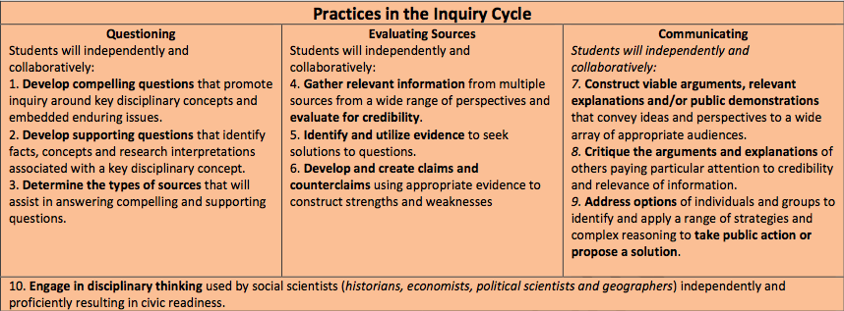
Highly Effective Teaching and Learning
Creating Compelling and Supporting Questions
Notes:
Carole or Jennifer: FOCUS FOR TODAY
Refer TLs to the laminated card: Practices in the Inquiry Cycle for Social Studies

Slide 7
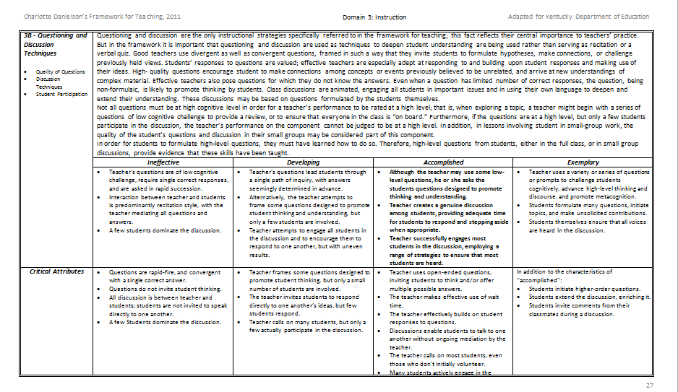
Domain 3: Instruction
3b – Questioning & Discussion Techniques
Notes:
Jennifer: Framework 3b: (Page 32 in the 8.5 format and Page 27 in the 8.5 by 14 format)
Instructions for Activity on next slide

Slide 8

Making Comparisons
Read the summary AND the descriptors for both the Accomplished and Exemplary category.
Summarize the difference between them.
With a discussion partner, share your summarizations.
Synthesize into a superior summarization at your tables and write it in your journal.
Instructional Strategy: FSLC (Formulate, Share, Listen, Create)
Notes:
Jennifer
Look at the critical attributes below that. See the distinguishing characteristics among the 4 categories.

Slide 9

Critical Attributes
In addition to the characteristics of accomplished:
  Students initiate higher-order questions.
  Students extend the discussion, enriching it.
  Students invite comments from their classmates during discussion.
Notes:
Jennifer
Clearly critical attributes of best practice have students initiating and leading the classroom.
High-quality questions encourage students to make connections among concepts or events previously believed to be unrelated, and arrive at new understandings of complex material. Effective teachers also pose questions for which they do not know the answers. Even when a question has limited number of correct responses, the question, being non-formulaic, is likely to promote thinking by students. Class discussions are animated, engaging all students in important issues and in using their own language to deepen and extend their understanding. These discussions may be based on questions formulated by the students themselves.
Not all questions must be at high cognitive level in order for a teacher’s performance to be rated at a high level; that is, when exploring a topic, a teacher might begin with a series of questions of low cognitive challenge to provide a review, or to ensure that everyone in the class is “on board.” Furthermore, if the questions are at a high level, but only a few students participate in the discussion, the teacher’s performance on the component cannot be judged to be at a high level. In addition, in lessons involving student in small-group work, the quality of the student’s questions and discussion in their small groups may be considered part of this component.
In order for students to formulate high-level questions, they must have learned how to do so. Therefore, high-level questions from students, either in the full class, or in small group discussions, provide evidence that these skills have been taught.

Slide 10
Consider this…
The teacher is usually the person who asks the questions during a discussion. In a longitudinal study of elementary and secondary school classes, Dillon (1990) found that each student asks only one question(s) per month on average. Teachers must take deliberate steps to get their students to ask questions.
Notes:
Jennifer
Ask participants to guess how often students ask questions.

Slide 11

Students' Questions as a Catalyst for:
Deeper Learning, Joy in Teaching and a Healthier Democracy
The Right Question Institute
www.rightquestion.org
Notes:
Carole
Introduction to Make Just One Change book and the Right Question Institute
Will receive copy of the book later… Intended for all grade levels and all content areas!!

Slide 12
The Big Idea
Students are more successful when they learn to ask their own questions.
Notes:
Carole
Process of learning
Example:
Parents not knowing what questions to ask…

Slide 13
Relevance to New Demands
Inquiry and Rigor
      Ky’s Framework for Teaching
      KCAS for Social Studies
      KCAS for Science
Notes:
Carole
What makes this “big idea” so relevant to you as a KY teacher?
Relevant to new requirements and 21s cent/global skills

Slide 14

Experiencing the Question Formulation Technique^{TM (QFT)}
Notes:
Carole

Slide 15
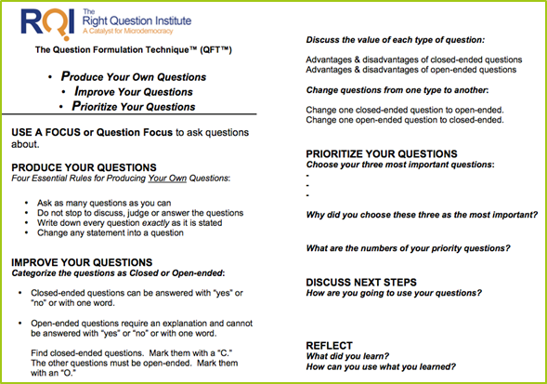
Components of the Question Formulation TechniqueTM
A Question Focus (Q-Focus)
  Rules for Producing Questions
  Producing Questions
  Categorizing Questions-Open/Closed
  Prioritizing Questions
Next Steps
Reflection

Slide 16
Rules for Producing Questions
Ask as many questions as you can.
Do not stop to answer, judge, or discuss.
Write down every question exactly as it was stated.
Change any statements into questions.
Notes:
Carole
Reference your handout for Question Formulation Technique.

Slide 17
Question Focus (Q-Focus)
A Question Focus IS a simple statement, a visual or aural aid to help students generate questions
  Created from curriculum content
  Brief
  Stimulates a new line of thinking
A Q-Focus is NOT
  A question
Notes:
Carole

Slide 18
Question Focus
Some students are not
asking questions in my classroom.
Notes:
Carole

Slide 19
Producing Questions – 4 min.
Some students are not
asking questions in my classroom.
Ask Questions
Follow the Rules
Number the Questions
Notes:
Carole
TLs will ask questions independently for 4 minutes on a piece of paper: (Produce Your Questions section of QFT handout, Bullet 1)
Combine questions on CHART PAPER following the rules 6 minutes (Bullet 2 of handout): No discussion about questions and write them down exactly as stated
Go through questions and change any statement into a question
Number the questions
Sample Questions:
How are the students who are not asking questions performing in your class
What kind of questions do I want students
Have I created an environment conducive to student questions
Why are they not asking questions
How can I model High Level questions for students
Does the classroom environment create a clrm of trust.
Do students feel comfortable asking questions
Do the students that are not asking questions know how to ask them
How can I teach students to ask effective questions

Slide 20
Categorizing Questions:
Closed/Open
Definitions:
  Closed-ended questions can be answered with a “yes” or “no” or with a one-word answer.
  Open-ended questions require
  more explanation.
Directions: Identify your questions as closed-ended or open-ended by marking them with a “C” or an “O”.
Notes:
Carole
Follow directions on slide and “Improve Your Questions” on QFT handout

Slide 21
Change Closed to Open -Ended Questions (Divergent Thinking)
Directions: Take one closed-ended question and change it into an open-ended question
CLOSED-ENDED
OPEN-ENDED
Notes:
Carole
Follow directions on slide and “Improve Your Questions” on QFT handout

Slide 22
Change Open to Closed -Ended Questions (Convergent Thinking)
Directions: Take one open-ended question and change it into an closed-ended question
OPEN-ENDED
CLOSED-ENDED
Notes:
Carole
Follow directions on slide and “Improve Your Questions” on QFT handout

Slide 23
Prioritizing Questions
Review your list of questions
Choose the three questions you consider most important
While prioritizing, think about your Q-Focus:
Some students are not asking
questions in my classroom.
Notes:
Carole
Follow directions on slide and “Prioritize Your Questions” on QFT handout

Slide 24
REFLECTION
Why did you choose those three questions as the most important?
Where are your priority questions in the sequence of your entire list of questions?
Which questions at your table are the most likely candidates for compelling questions? Supporting questions?
Notes:
Carole
Follow directions on slide and “Prioritize Your Questions” on QFT handout

Slide 25
Classroom Example:
Elementary School
Teacher: Mitch Mosbey, Noblesville, IN
Grade: First grade
Purpose: Prepare for a unit that talks about rules and responsibilities as well as introduce the 7 Habits of Highly Effective Kids.
Example Source:
http://www.primarytechteaching.com/blog/question-formulation-technique-with-primary-grades
Notes:
Carole
Let’s quickly look at some examples…
In-Depth Look at a Sharply Focused Strategy

Slide 26
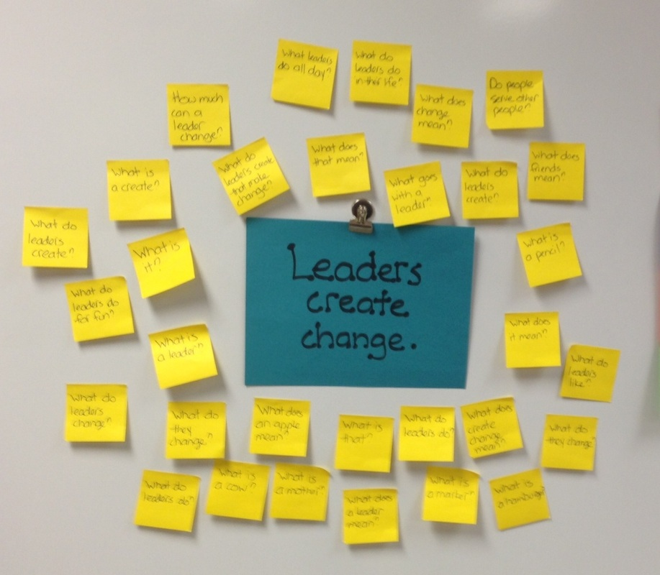
Question Focus
Image source:
http://www.primarytechteaching.com/blog/question-formulation-technique-with-primary-grades
Notes:
Carole

Slide 27
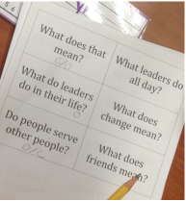
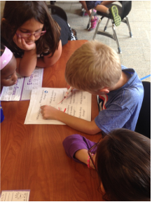
Student Questions
Priority Questions:
  What do leaders create?
  What do they change?
  What do leaders create to make change?
Image source: http://www.primarytechteaching.com/blog/question-formulation-technique-with-primary-grades
Notes:
Carole

Slide 28
Classroom Example:
Middle School
Teacher: Megan Harvell, Boston, MA
Topic: American History –The Civil War
Purpose: Pre-reading activity to engage students
Notes:
Carole

Slide 29
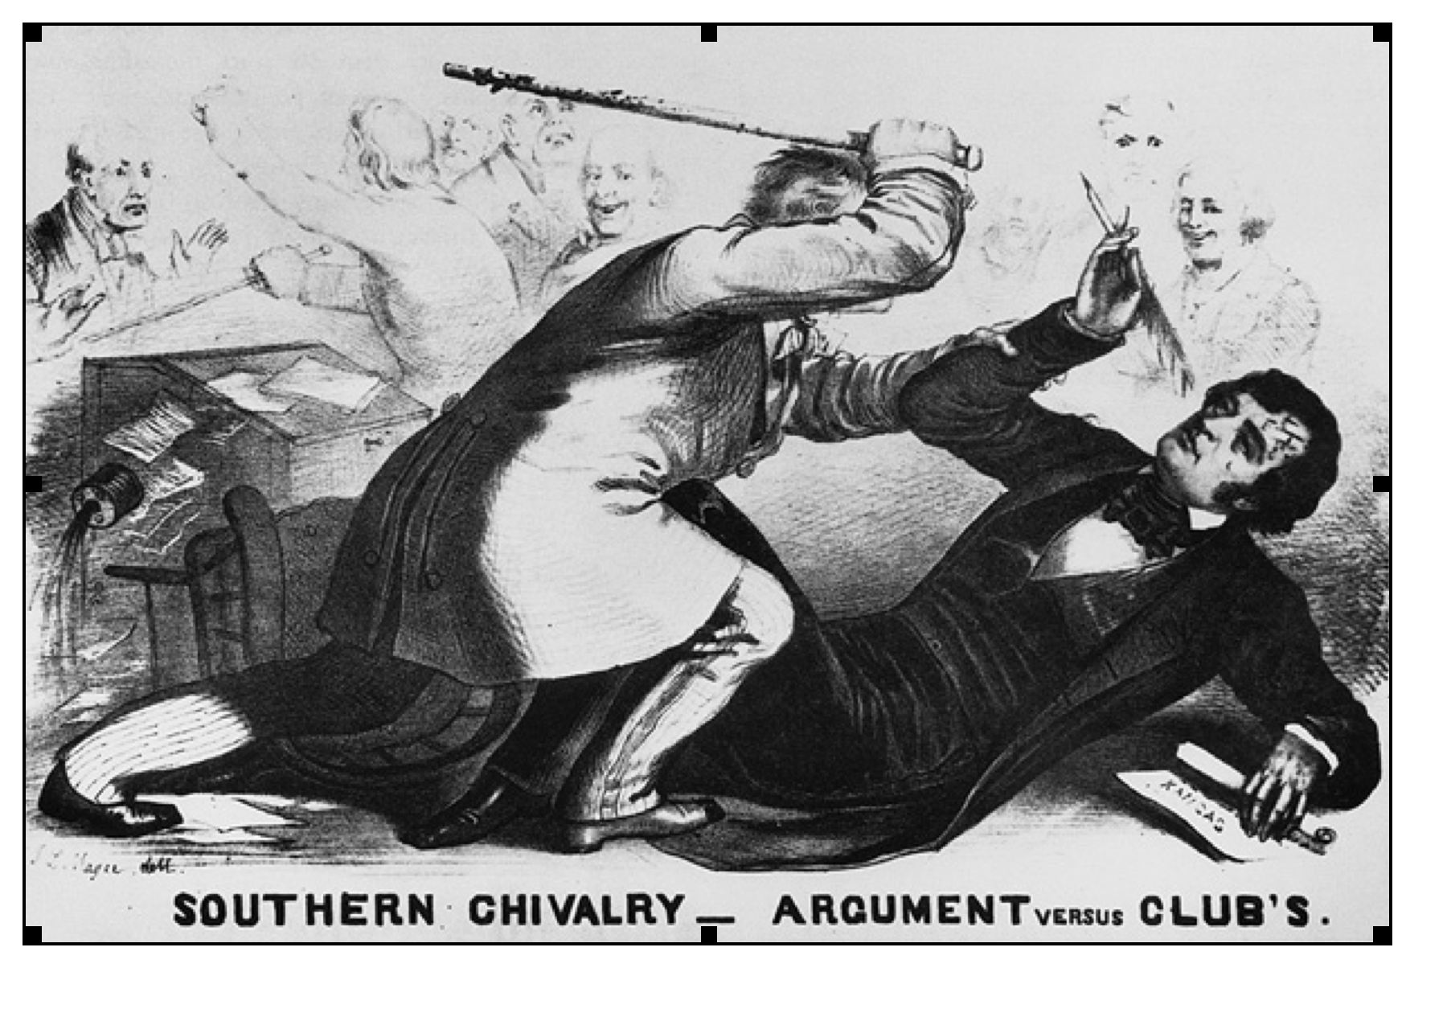
Question Focus
Notes:
Carole
Using a visual only

Slide 30
Student Questions
Why are they fighting?
Are they fighting?
Are they part of the government?
Where were they?
Who are they?
Were they signing anything?
Who else was there?
Why are you hitting him?
Why didn’t they call 911?
Was this related to slavery?
Why is he hitting him with a bat?
Why are you taking a pen?
Why are they in court?
Who hit who first?
Who died?
Why are they smiling?
Notes:
Carole

Slide 31
The Discovery of Rigor:
Three Thinking Abilities in One Process
  Divergent
  Convergent
  Metacognitive
Notes:
Carole

Slide 32
Thinking in many different directions: Moving from CLOSED to OPEN QUESTIONS
DIVERGENT
THINKING
Notes:
Carole

Slide 33
Narrowing Down, Focusing
Moving from OPEN to CLOSED
CONVERGENT
THINKING
Notes:
Carole

Slide 34

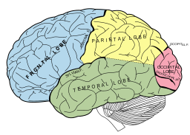
Thinking about Thinking
METACOGNITIVE
THINKING:
“Why did
you pick those as
your priority
questions?”
Notes:
Carole

Slide 35
Connections
Connecting Question Formulation Technique to the Inquiry Practices
Notes:
Carole

Slide 36
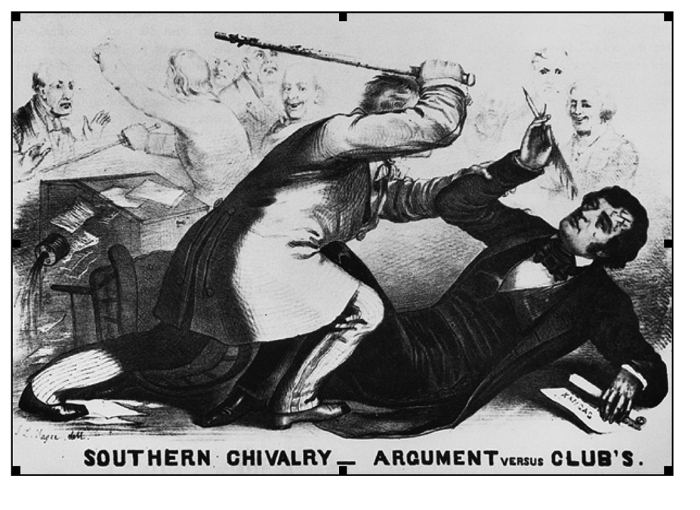
Questioning: Developing Compelling and Supporting Questions
Why are they fighting?
Are they fighting?
Are they part of the government?
Where were they?
Who are they?
Were they signing anything?
Who else was there?
Why are you hitting him?
Why didn’t they call 911?
Was this related to slavery?
Why is he hitting him with a bat?
11. Why are you taking a pen?
12. Why are they in court?
13. Who hit who first?
Who died?
Why are they smiling?
Supporting Questions
“Focus on descriptions, definitions, and processes on which there is general agreement within the social studies disciplines, and require students to construct explanations that advance claims of understanding in response”
C3 Framework p.23
Compelling Questions
“Focus on enduring issues and concerns. They deal with curiosities about how things work; interpretations and applications of disciplinary concepts; and unresolved issues that require students to construct arguments in response.”
C3 Framework p.23
Notes:
Carole

Slide 37
Sample Compelling Questions
What is the significance of the pen and paper in Butler’s hand?
What about Sumner’s speech was so insulting to the slave owning class that Senator Butler represented?
How did the various political factions respond to the event?
What were the motivations for these responses and what implications did the choices of these political factions have for the viability of the Union?
Notes:
Carole
Develop a supporting question for one of the four samples.

Slide 38

Inquiry Practice and QFT Connections
Are we done with questions?
How and when would QFT be appropriate in other places within the inquiry cycle?
(1-1-1 Strategy)
Engaging in Disciplinary Thinking
  “Working with a robust compelling question and a set of discrete supporting questions, teachers and students determine the kind of content they need in order to develop their inquiries.” C3 p17
Questions and Inquiry
  Compelling question
  Supporting questions
Notes:
Carole
Talk as a table about how and when QFT would be appropriate in the entire inquiry cycle?

Slide 39
The Research Confirms the Importance of Student Questioning
Self-Questioning (metacognitive strategy):
Students formulating their own questions proved to be one of the most effective metacognitive strategies
Engaging in pre-lesson self-questioning improved students rate of learning by nearly 50% (Hattie, p.193)
Visible Learning: A Synthesis of Over 800 meta-Analyses Relating to Achievement by John Hattie. 1st Edition, December 26, 2008.
Notes:
Carole

Slide 40



Reflection
What did you learn?
How did you learn it?
What do you understand differently now about asking questions?
Notes:
Carole

Slide 41
Connection: Framework for Teaching
Highly Effective Teaching and Learning
Notes:
Jennifer

Slide 42
FfT 3B - Possible examples
Developing
Ineffective
All questions are of the “recitation” type such as “What is 3 x 4?”
The teacher asks a question for which the answer is on the board; students respond by reading it.
The teacher calls only upon students who have their hands up.
Many questions are of the “recitation” type, such as “How many members of the House of Representatives are there?”
The teacher asks: “Who has an idea about this?” but only the usual three students offer comments.
The teacher asks: “Michael can you comment on Mary’s idea?” but Michael does not respond or makes a comment directly to the teacher.
Notes:
Jennifer

Slide 43
Possible examples
Accomplished
Exemplary
The teacher asks: “What might have happened if the colonists had not prevailed in the American war for independence?”
The teacher uses the plural form in asking questions, such as “What are some things you think might contribute to . . .?”
The teacher asks; “Michael, can you comment on Mary’s idea?” and Michael responds directly to Mary.
After posing a question and asking each of the students to write a brief response and then share it with a partner, the teacher invites a few to offer their ideas to the entire class.
A student asks, “How many ways are there to get this answer?”
A student says to a classmate: “I don’t think I agree with you on this, because . . .”
A student asks of other students: “Does anyone have another idea how we might figure this out?”
A student asks, “What if . . .?”
Notes:
Jennifer

Slide 44
Scenario Activity
Find the “Can You Identify the Correct Level of Performance” in today’s packet.
Read the scenarios (numbered 1-8) and on your answer sheet jot down where you think it falls on the continuum.
When all are ready, discuss as a table your findings. Use the FfT and scenarios for evidence.
Notes:
Jennifer
Of course no one would make a determination of a teacher’s overall performance based on a five minute observation, this is just a sample of what was observed. Frame this activity with that in mind.
Give answers…

Slide 45
Other Framework for Teaching Connections
Domain 1 Planning & Preparation | Domain 2 Classroom Environment | Domain 3 Instruction | Domain 4 Professional Responsibilities
Demonstrating Knowledge of Content and Pedagogy Knowledge of Content and the Structure of the Discipline Knowledge of Prerequisite Relationships Knowledge of Content-Related Pedagogy Demonstrating Knowledge of Students Knowledge of Child and Adolescent Development Knowledge of the Learning Process Knowledge of Students’ Skills, Knowledge, and Language Proficiency Knowledge of Students’ Interests and Cultural Heritage Knowledge of Students’ Special Needs Selecting Instructional Outcomes Value, Sequence, and Alignment Clarity Balance Suitability for Diverse Learners Demonstrating Knowledge of Resources Resources for Classroom Use Resources to Extend Content Knowledge and Pedagogy Resources for Students Designing Coherent Instruction Learning Activities Instructional Materials and Resources Instructional Groups Lesson and Unit Structure Designing Student Assessment Congruence with Instructional Outcomes Criteria and Standards Design of Formative Assessments Use for Planning | Creating an Environment of Respect and Rapport Teacher Interaction with Students Student Interactions with One Another Establishing a Culture for Learning Importance of the Content Expectations for Learning and Achievement Student Pride in Work Managing Classroom Procedures Management of Instructional Groups Management of Transitions Management of Materials and Supplies Performance of Non-Instructional Duties Supervision of Volunteers and Paraprofessionals Managing Student Behavior Expectations Monitoring of Student Behavior Response to Student Misbehavior Organizing Physical Space Safety and Accessibility Arrangement of Furniture and Use of Physical Resources | Communicating with Students Expectations for Learning Directions and Procedures Explanation of Content Use of Oral and Written Language Using Questioning and Discussion Techniques Quality of Questions Discussion Techniques Student Participation Engaging Students in Learning Activities and Assignments Grouping of Students Instructional Materials and Resources Structure and Pacing Using Assessment in Instruction Assessment Criteria Monitoring of Student Learning Feedback to Students Student Self-Assessment and Monitoring of Progress Demonstrating Flexibility and Responsiveness Lesson Adjustment Response to Students Persistence | Reflecting on Teaching Accuracy Use in Future Teaching Maintaining Accurate Records Student Completion of Assignments Student Progress in Learning Non-Instructional Records Communicating with Families Information About the Instructional Program Information About Individual Students Engagement of Families in the Instructional Program Participating in a Professional Community Relationships with Colleagues Involvement in a Culture of Professional Inquiry Service to the School Participation in School and District Projects Growing and Developing Professionally Enhancement of Content Knowledge and Pedagogical Skill Receptivity to Feedback from Colleagues Service to the Profession Demonstrating Professionalism Integrity and Ethical Conduct Service to Students Advocacy Decision Making Compliance with School and District Regulations
Notes:
Jennifer (Page 3 of 8.5 format)
The connection between QFT and Danielson’s Fft is evident in 3B Using Questioning and Discussion Techniques but looking more braodly it is possible to make connections in all areas of Danielson’s Framework.
Consider 1E- Remember Domain 1 is about planning and preparation and E is specific to designing coherent instruction. If you are going to use the QFT with students you would first decide in what part of the instruction you will do it based on the outcomes of the lesson.
Will it be at the beginning to spark students thinking about a topic?
Will you use it in the middle to give students a way to gather their thoughts before beginning a writing assignment (formative assessment for you to see what they know)
Or will it be at the end of a chunk of learning so they can reflect and make connections and you can assess in a summative way…
This all gets to the attributes of effective teaching and learning described in 1E.
Learning experiences aligned to instructional outcomes –varied use of instructional groups—significant cognitive challenge---
Then look at Domain 2 Classroom Environment.
Classroom culture is cognitively busy…Students understand their role as learner…teacher conveys high expectations for learning
Domain 4 connection will be made when you share the QFT (and other learning) with your colleagues in your building and district.

Slide 46
Experience a Social Studies Lesson Using the Question Formulation Technique^{TM (QFT)}
Grades K-4:
Report to Breakout Session Room

Slide 47

LUNCH
12:15 – 1:00 p.m.
Notes:
Distribute Make One Change and CASL books during lunch.

Slide 48

Preparing to Use the QFT
Please take a little more time and work on your plan for incorporating QFT into an upcoming unit of study.
Notes:
Carole
Distribute “Recommendations on Facilitating” handout to TLs as another resource.

Slide 49

Defining Defensible Evidence: Mastery of Questioning
Defensible Evidence: examples from instructional practice that can be defended as mastery of a skill.
Using today’s learning and resources, brainstorm what is proficient level of questioning?
Can you affirm or revise the criteria from the FfT?
What evidence can you provide from your classroom that students are mastering the art of questioning?
Notes:
Carole
If an administrator was in your classroom observing or you were having a pre/post conference about the observation, what would your “defensible evidence” of student mastery “look like”?
Let’s begin by defining it…

Slide 50

Maximize Your Professional Learning
  Make Just One Change: Read Chapter 9: “A Memo to My Fellow Teachers”
Implement the QFT Process with your students (suggest to do this 2 times)
Bring DEFENSIBLE EVIDENCE of EFFECTIVE STUDENT QUESTIONING to the DECEMBER 2ND meeting. DEFENSIBLE EVIDENCE of QUESTIONING MASTERY (narratives, pictures, video, student work, etc.)
Reflect upon your QFT experience by making notes in your journal about the lesson and student’s responses.
December 2nd TLN Meeting: Grade Level Group Share-A-Thon
Notes:
Carole
You’ve begun a plan as to how to incorporate QFT into a unit of study…
We want to give you time to share your experience with QFT, Topics; tips/suggestions/ideas; lessons learned, etc.

Slide 51

Assessment Literacy
*Comparing the current Assessment CONCEPT DRAFT for Science to
FUTURE Social Studies Assessment
*Sharpen our understanding of formative and summative assessment and its impact on learning.
Notes:
Teresa

Slide 52
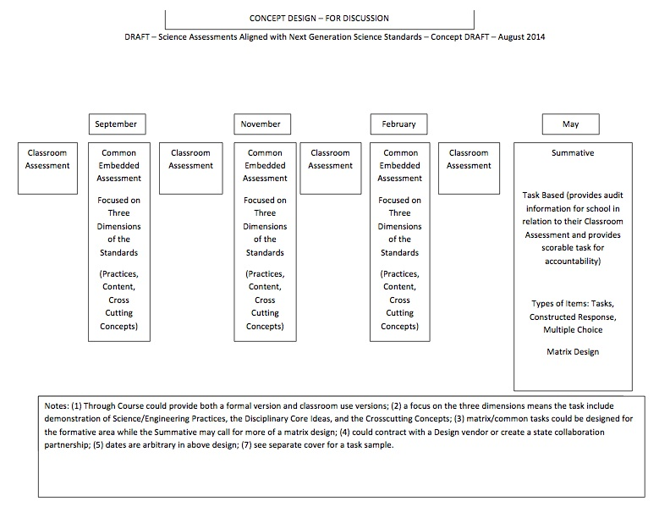

Slide 53


CASL-- Debrief
Individually,
Jot down key words to define formative assessment
Collectively,
Choose 4 key words to define
formative assessment
Notes:
Teresa

Slide 54


SAT
Thumbs up/thumbs down
Classroom Response System (Clickers)
Final Exams
KCCT
An Essay
Science Journals
Football practice
Science experiment
Class discussion
Socratic seminar
Commercial online skills assessment
Speech
ACT
Band Tryouts/auditions
Notes:
Teresa

Slide 55



Effects of Formative Assessment
Research by Black and Wiliam shows .4-.7 SD gains in student achievement.
This translates to:
25 Percentile Points on ITBS
70 SAT Score Points
4 ACT Score Points
2013 Average ACT score in KY 19.6
Notes:
Teresa
Inside the Black Box details the implications of using Formative Assessment. The 2010 ACT composite average is an 18. This research implies that the average TRIGG CO. high school junior would have scored a 22. Other than the short term effects, consider the long term effects of more students being college ready…on the economy, justice department, welfare system, etc.

Slide 56
Black & William Black & William
The way a teacher designs assessments and applies assessment data (how a teacher assesses)…can lead to substantial increases in instructional effectiveness.
Research shows that the key to student achievement lies in assessments administered in the classroom.
Research shows that the key to student achievement lies in assessments administered in the classroom.
W. James Popham
Notes:
Teresa

Slide 57

These are the assessments that we conduct throughout teaching and learning to diagnose student needs, plan our next steps in instruction, provide students with feedback they can use to improve the quality of their work, and help students see and feel in control of their journey to success.
Stiggins, et al
Notes:
Teresa

Slide 58
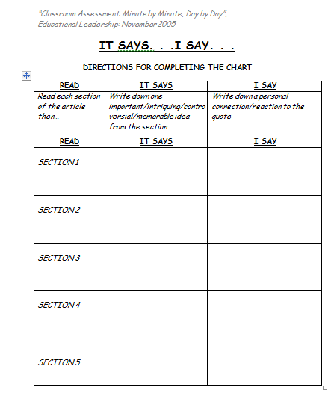

Slide 59
Formative Assessment
Long-cycle
Medium-cycle
Short-cycle
Notes:
Teresa

Slide 60
Typology of Kinds of Formative Assessment
Type | Focus | Length
Long-cycle | Across marking periods, quarters, semesters, years | 4 weeks to 1 year
Medium-cycle | Within and between instructional units | 1 to 4 weeks
Short-cycle day-by-day minute-by- minute | Within and between lessons | 24-48 hours 5 seconds to 2 hours
Notes:
Teresa
The addition this year is to move beyond the short-cycle FAs and to include the medium-cycle FAs.

Slide 61
SAT
Thumbs up/thumbs down
Classroom Response System (Clickers)
Final Exams
KCCT
An Essay
Science Journals
Football practice
Science experiment
Class discussion
Socratic seminar
Commercial online skills assessment
Speech
ACT
Band Tryouts/auditions
Notes:
Teresa

Slide 62

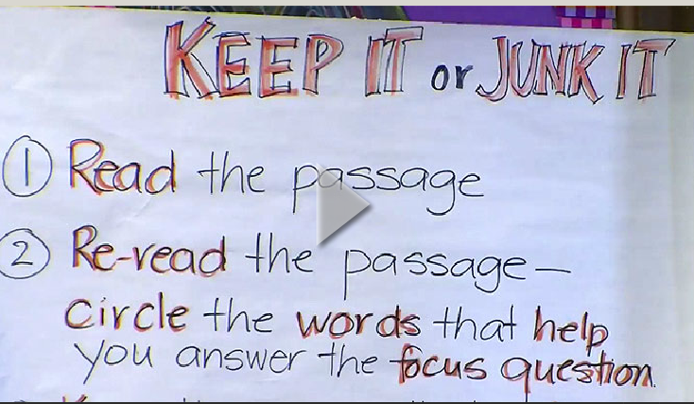
Partner Listening
Partner #1– Document examples of when students are learning.
Partner #2– Document examples of when teacher is assessing.
Notes:
Teresa
As you watch the video

Slide 63

Share your lists
Create a non-linguistic representation that represents your response to this prompt:
What is the relationship between when students are learning and a teacher is assessing?
Notes:
Teresa

Slide 64
What Are Your Learning Needs?
Meet in grade level bands (K-1; 2-3; 4-5; 6-8; 9-10; 11-12)
Using your completed PL Activity Template:
  Prioritize the top 5 PL needs in order (1being the most important)
Share with others in your grade band.
As a grade band, determine your TOP 3 PL needs.
Place these TOP 3 PL needs on the provided color handout and submit to one of the facilitators.
Notes:
Carole
Professional Learning Feedback Activity
Each grade band will be given a different colored handout on which to submit their needs

Slide 65

Social Studies Standards:
Projected Timeline At A Glance…
September 2014 Targeted Focus Groups
October 2014 First Read KBE and compile feedback
November 2014 Representative sub-group of standards writers will meet to review Feedback and Refine Draft
December 2014 Second Read
***DELAYED for more feedback***
January 27, 2015 KVEC SSTLN Meeting Cancelled
3 SUMMER DATES for Social Studies Network
  Tentative
2015-2016 Projected Implementation
Notes:
Carole: YOUR VOICES WERE HEARD!!
I have posted the electronic version of the Commissioner’s announcement about the delay of action on SS and Arts Standards on our website. It also contains information about the upcoming feedback site.
Seeking Feedback for Social Studies and Arts Standards
At the October Kentucky Board of Education meeting, a first draft of new Social Studies standards was shared, as was the set of National Core Arts Standards developed by the National Coalition for Core Arts Standards.
Senate Bill 1 (2009) calls for Kentucky to revise all standards to be aligned with the latest research, informed by national efforts, internationally comparable, and focused on the critical thinking and practices students need for success in the 21st century.
Though both sets of standards have met those criteria and have involved Kentucky educators, it is time to seek even broader feedback to inform next drafts/steps in the process of adoption into Kentucky’s required Academic Standards.
Beginning Monday, November 3 and going through Friday, December 5, all interested Kentucky citizens (and even those outside our state) will be invited to review the proposed standards in Social Studies and the Arts and share feedback and suggestions that will be used to revise/refine them prior to final consideration for adoption.
Because we anticipate a large response to this invitation, we will be delaying action by the Kentucky Board of Education until after the December meeting. Feedback and comments will need to be thoughtfully considered and any needed revisions made before bringing forward final sets of proposed standards to the board for action.
A link to the online survey will be sent next Friday, October 31.

Slide 66
Unpacking Your Day
Notes:
Carole
Make connections to the pillars

Slide 67
REMEMBER: Maximize Your Professional Learning
  Make Just One Change: Read Chapter 9: “A Memo to My Fellow Teachers”
Implement the QFT Process with your students (suggest to do this 2 times)
Bring DEFENSIBLE EVIDENCE of EFFECTIVE STUDENT QUESTIONING to the DECEMBER 2ND meeting. DEFENSIBLE EVIDENCE of QUESTIONING MASTERY (narratives, pictures, video, student work, etc.)
Reflect upon your QFT experience by making notes in your journal about the lesson and student’s responses.
December 2nd TLN Meeting: Grade Level Group Share-A-Thon
Notes:
Carole
You’ve begun a plan as to how to incorporate QFT into a unit of study…
We want to give you time to share your experience with QFT, Topics; tips/suggestions/ideas; lessons learned, etc.

Slide 68

Remember…
    Turn in your Evaluation
    Get your certificate
    Our next meeting is:
2, 2014
Notes:
Carole
Complete Evaluation
Distribute Certificates

